Slide 1
Price Fixing Cartels and Firm Innovation
How Does Price Competition Affect Innovation? Evidence from U.S. Antitrust Cases
Hyo Kang
Assistant Professor
Marshall School of Business
University of Southern California
April 2024
34th Annual POMS Conference

Slide 2
Research Overview
How does market competition affect innovation?
How does price competition affect firm innovation activities?
How do price fixing cartels change innovation activities of firms that colluded?
Intensity of innovation
Breadth of innovation
Overview
Setting
Design
Results
Mechanisms
Discussion

Slide 3
“The Competition-Innovation Debate”
Market competition promotes innovation
High marginal benefit (royalty) from innovation
Post-innovation rent >> pre-innovation rent
“Escape-competition effect” (Arrow 1962)
Market power promotes innovation
Predictability and appropriability (incentives to innovate)
Financial resources (ability to innovate)
Competition doesn’t allow excess capacity and strategic use of it
Overview
Setting
Design
Results
Mechanisms
Discussion
“The best of all monopoly profits is a quiet life” (Hicks 1935)
“A monopoly position is no cushion to sleep on” (Schumpeter 1942)

Slide 4
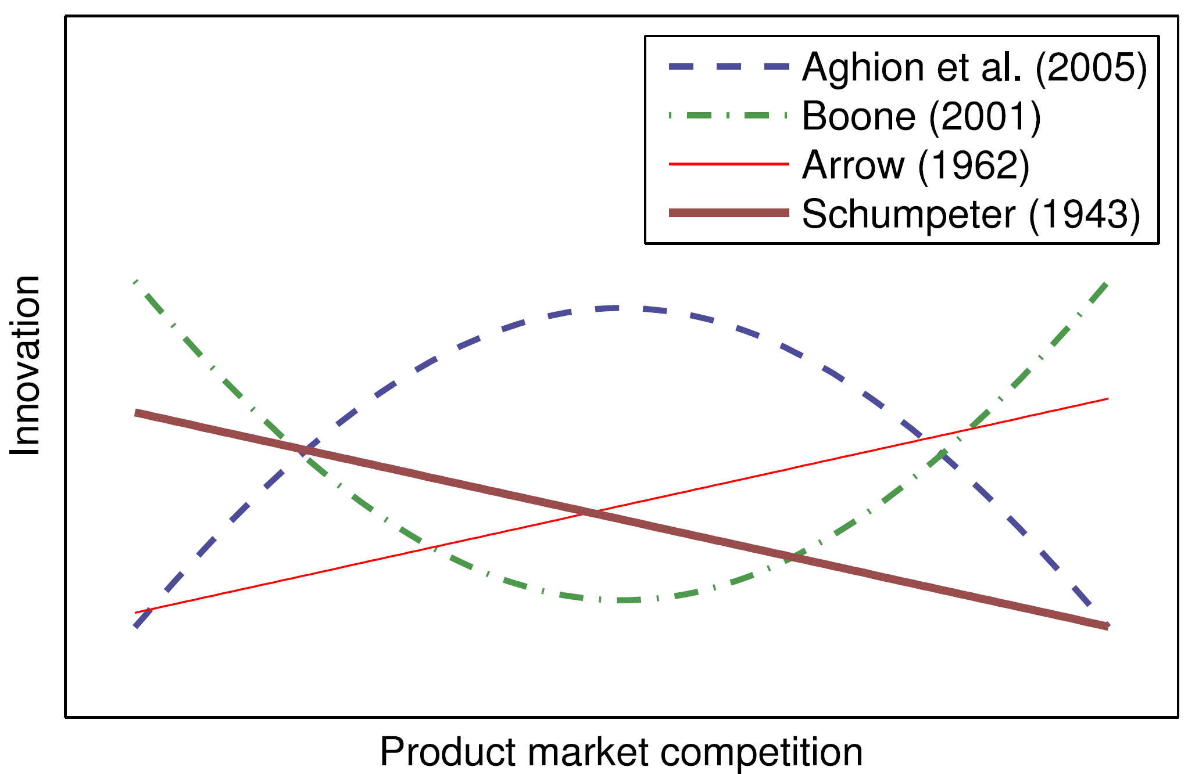
We have limited understanding…
Theory remains unclear
Empirical evidence is scarce and inconclusive
Im, Park, and Shon (2015; p. 79)
Overview
Setting
Design
Results
Mechanisms
Discussion
Notes:
We Remain Where We Started

Slide 5
Challenges in empirical studies:
Competition is hard to measure
Herfindahl–Hirschman Index (HHI)
CR_{N}: market share of N largest firms
Competition and innovation are endogenously determined
Reverse causality & simultaneity
Omitted variable bias & confounders
Data availability
Business data
Innovation data
Overview
Setting
Design
Results
Mechanisms
Discussion

Slide 6
This paper addresses these challenges...
Price-fixing Cartels: formation and breakup of cartel discontinuously change the level of competition
Constructed data on all 461 prosecuted cartels (1975-2016)
Large-scale combination of data from USPTO, Compustat, and US Census Research Data Center (RDC)
Difference-in-differences
Compare firms that colluded (Tr) to matched counterfactual firms (Ct)
Overview
Setting
Design
Results
Mechanisms
Discussion

Slide 7

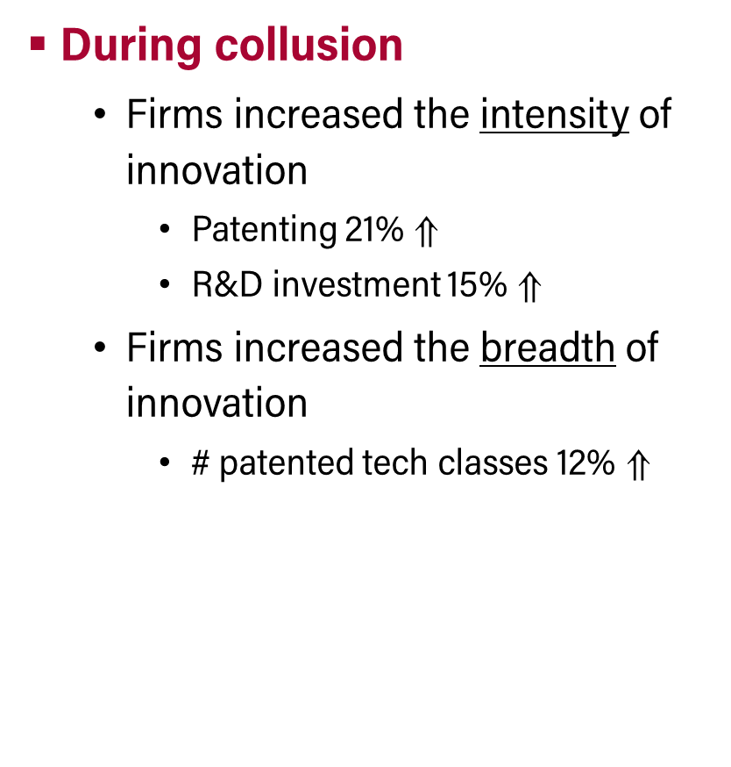
Preview of Results
During collusion
Firms increased the intensity of innovation
Patenting 21% $⇑$
R&D investment 15% $⇑$
Firms increased the breadth of innovation
# patented tech classes 12% $⇑$
After the breakup
Reverted back to pre-collusion levels
Overview
Setting
Design
Results
Mechanisms
Discussion
Price
Competition
Innovation
growth
The effects are greater for firms:
in stronger collusion and in fast-growing industries
that had limited access to external fund and enjoyed high revenue growth

Slide 8
Outline
Research Design and Data
Main Results
Mechanisms
Discussion
Overview
Setting
Design
Results
Mechanisms
Discussion

Slide 9
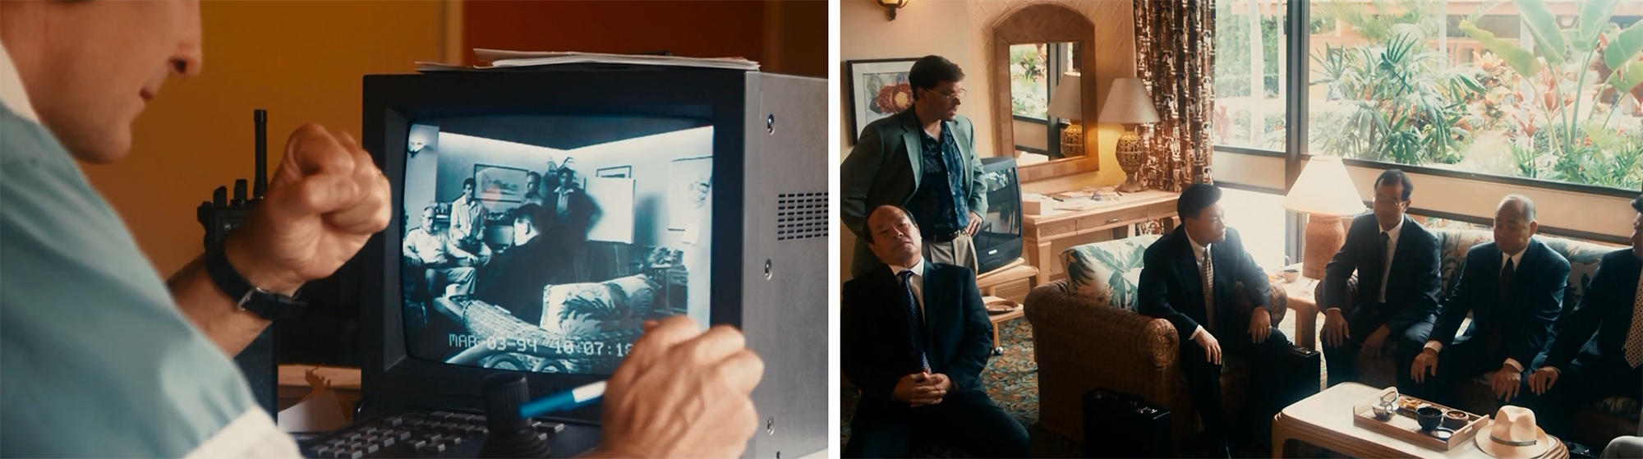
Source of Variation: Cartels
Cartels increase price and reduce competition
Per se illegal and felony punishable as federal crimes
DOJ and FBI use covert methods to gather evidence
The determinants of cartel breakup are legal factors, not economic factors (Levenstein & Suslow 2011)
Overview
Setting
Design
Results
Mechanisms
Discussion
FBI investigators monitor a meeting discussing the price level. Screenshot from the true-story-based movie, The Informant! (2009).

Slide 10
Data
Cartel data
Assembled a dataset on all prosecuted cases
Antitrust Case Filings, Dept of Justice: 2,000+ docs (1970–2021)
Trade Regulation Reporter, Commercial Clearing House: 2,400+ docs (1977–2021)
Media coverage and lawsuits
Identified 1,818 firms in 461 cartels (price fixing; bid rigging; market allocation)
Patent data
PatentsView by USPTO (1976–2021)
R&D expenditure
Compustat by Standard & Poor’s (1950–2021)
SIRD & BRDIS (1972–2018) from US Census RDC
Overview
Setting
Design
Results
Mechanisms
Discussion
Notes:
DOJ Data:
Web-crapping from their webpage (using R): 1,900 cases
Downloaded and complied legal documents: 4,000+ PDF files
Information, Plea Agreement, etc.
OCR: low quality
CCH Data:
Automated 30% of the work (using patterns in the digital files)
Manually reviewed and coded the remaining 70%
Hired a freelancer from Upwork, but did not work well
Grouped defendant-level data at the cartel-level
Was not obvious
Longitudinal Employer–Household Dynamics (LEHD) (1990-), incomplete
Business
Standard Statistical Establishment List/Business Register (SSEL), Annually, Establishment, 1974–2016
Longitudinal Business Database (LBD), Annually, Establishment, 1976–2016
Manufacturing
Census of Manufactures (CMF), Every 5 Years, Establishment, 1963, 1967–2012
Annual Survey of Manufactures (ASM), Annually, Establishment,1973–2016, 2018
Innovation
SIRD (1972-2007), BRDIS (2008-2016)
Annual Survey of Entrepreneurs (2014-2016)
Kauffman Firm Survey (2004-2010)
Apply for access (work with local RDC administrator)
Project Description (PD)
Predominant Purpose Statement (PPS)
Timeline
Preparing PD/PPS (3-6 months)
Census review (6-12 months), w/o LEHD
Background check and access (1-3 months)
The fastest way is to join an existing project
Yet, your access is project-specific (PD/PPD), for four years
Risky for job market paper
Fee
RDC Data Center in Berkeley and USC

Slide 11
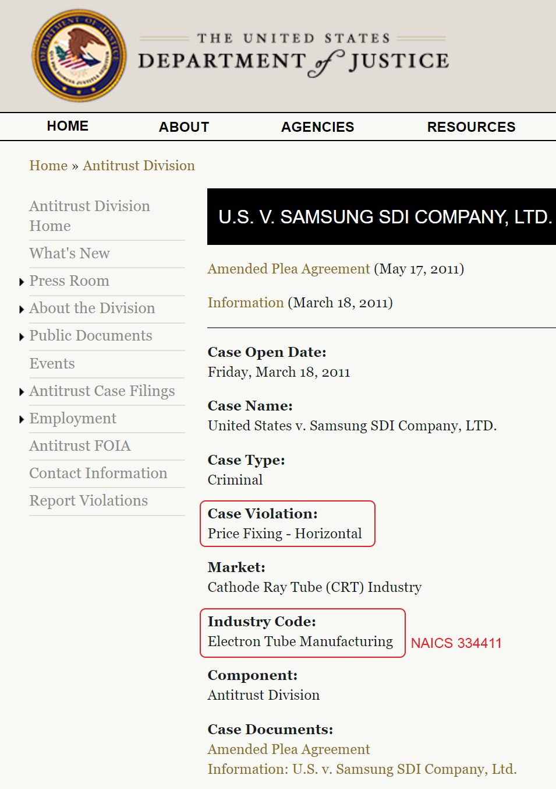
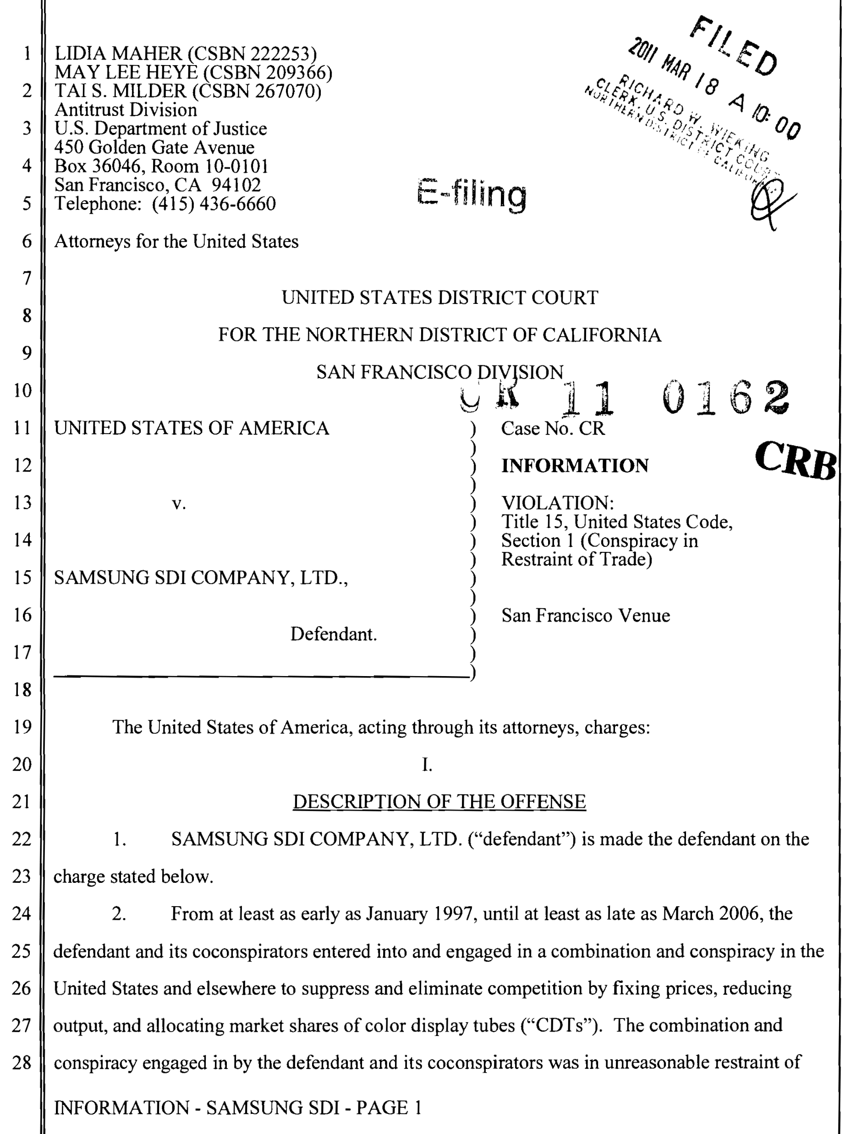
Cartel Data: DOJ
DOJ Webpage
Information (Indictment)
Overview
Setting
Design
Results
Mechanisms
Discussion

Slide 12
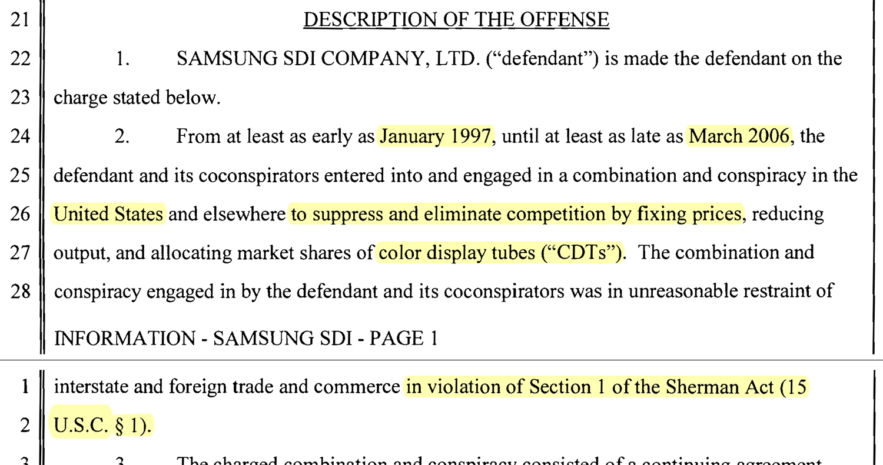
Information (Indictment) – 4 pages
Overview
Setting
Design
Results
Mechanisms
Discussion

Slide 13
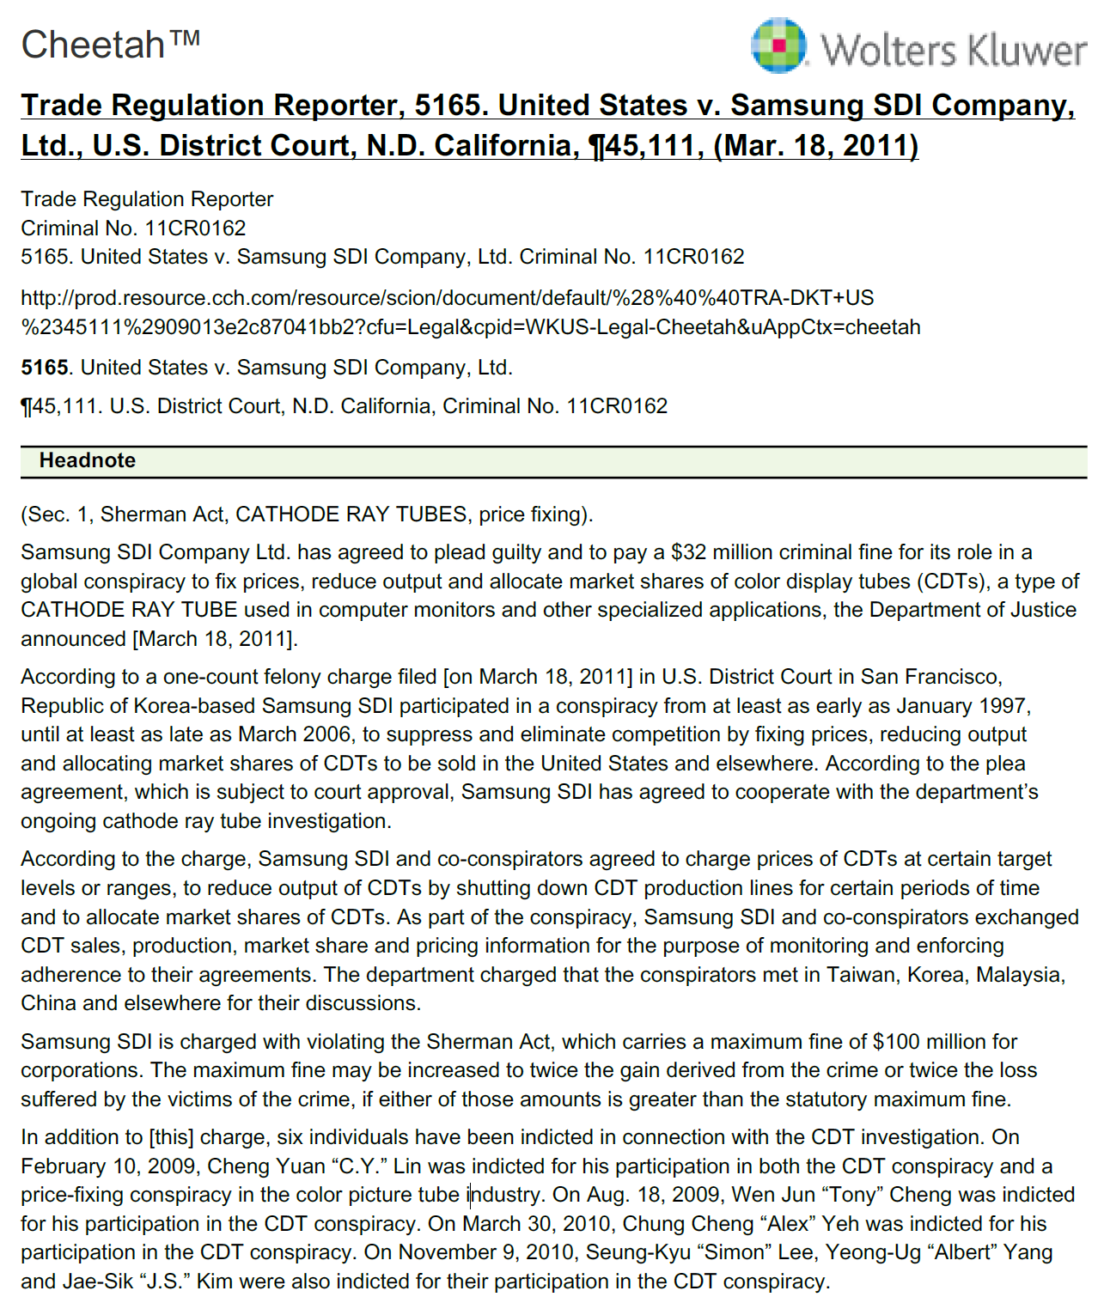
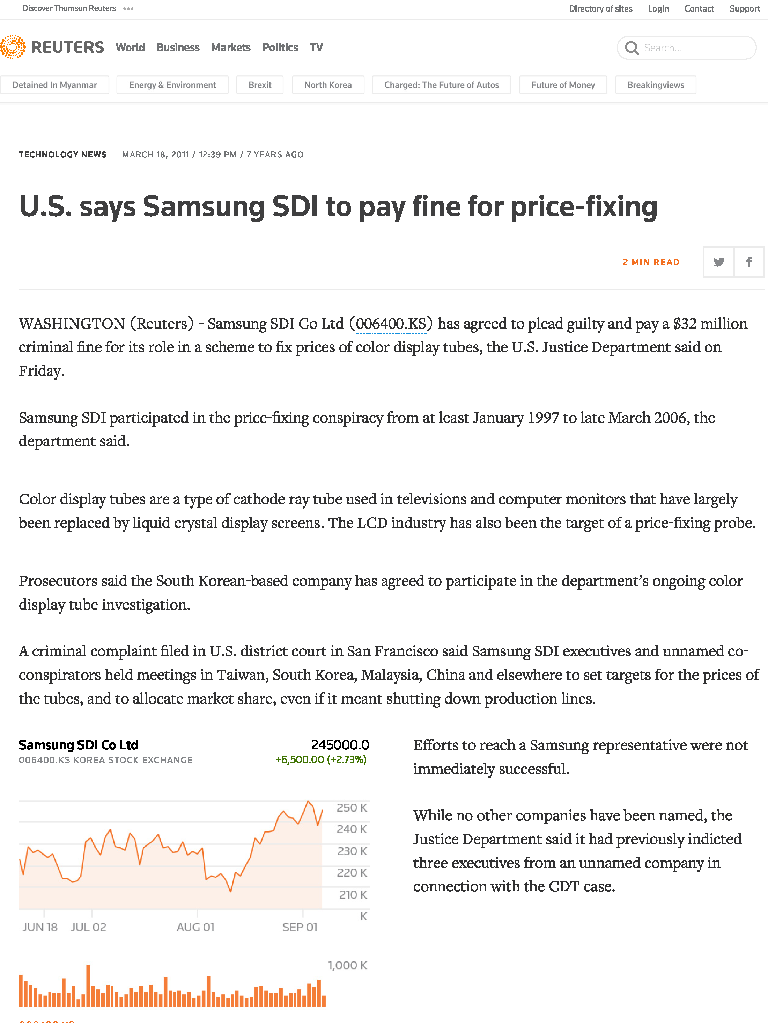
Cartel Data: CCH and News Media
CCH: Trade Regulation Reporter
News Coverage (Reuters)
Overview
Setting
Design
Results
Mechanisms
Discussion

Slide 14
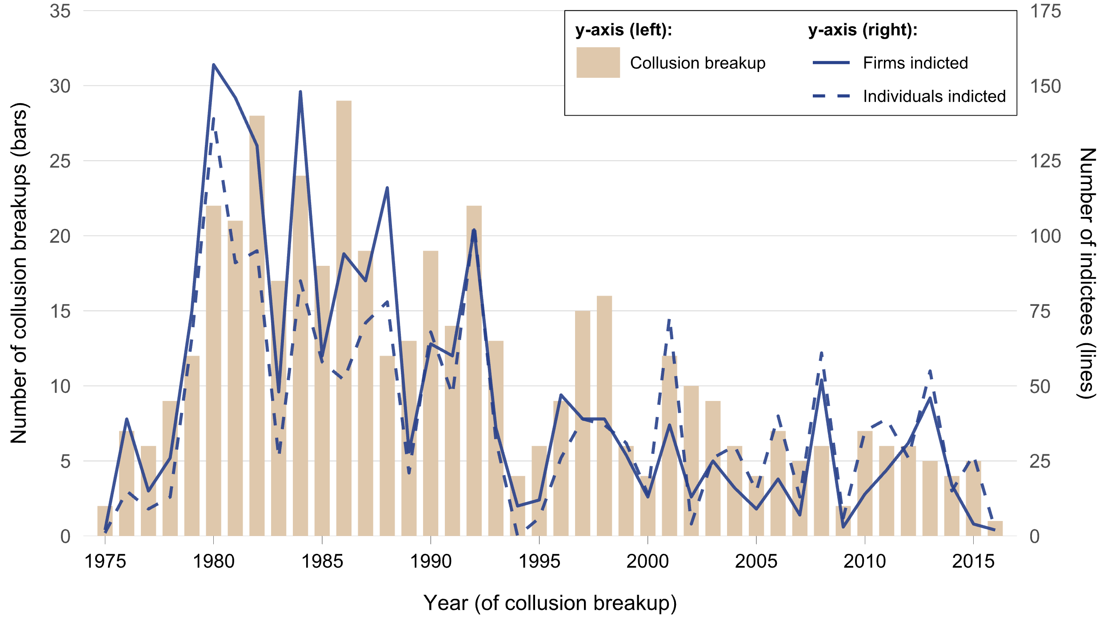
Cartels in the United States, 1975–2016
Overview
Setting
Design
Results
Mechanisms
Discussion

Slide 15
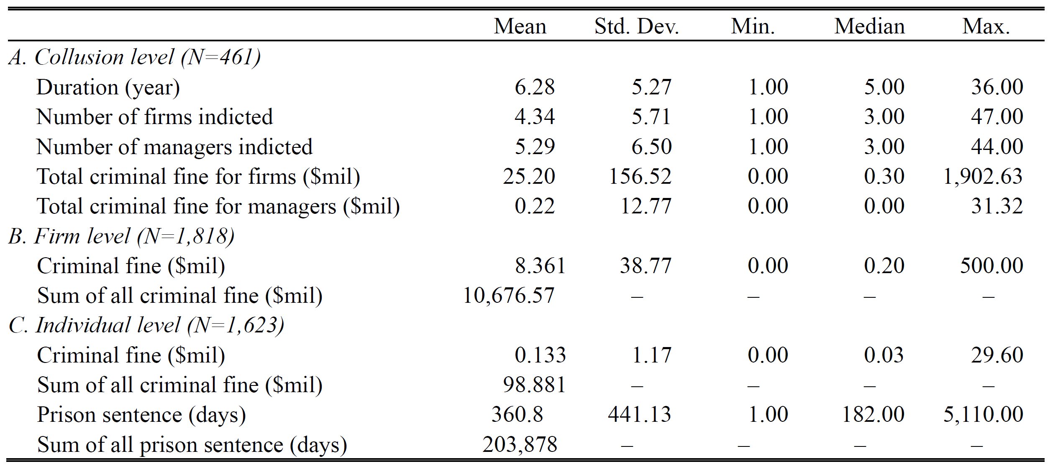
Descriptive Statistics: Collusion Data
Overview
Setting
Design
Results
Mechanisms
Discussion

Slide 16
Empirical Strategy: Difference-in-differences
Treatment (sources of variation):
Formation of cartels
Breakup of cartels
Treated group: Colluding firms
Comparison group: Non-colluding firms in adjacent industries
$$y_{ijt}=β_{1}⋅Treat_{i}⋅Post_{it}+β_{2}⋅Post_{it}+ρ_{i}+γ_{jt}+ε_{it}$$
Overview
Setting
Design
Results
Mechanisms
Discussion

Slide 17
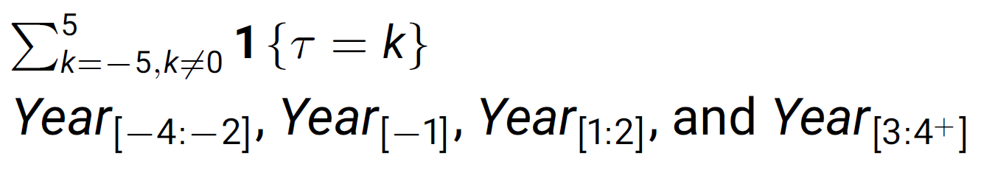
Time Indicators (“Post”)
Diff-in-Diff
More flexible approach
Replacing Post with
Replacing Post with
Event
PRE | POST
Overview
Setting
Design
Results
Mechanisms
Discussion
-4 | -3 | -2 | -1 | 1 | 2 | 3 | 4
PRE | -1 | Early-POST | Late-POST

Slide 18
Main Challenges
Choice of comparison group
Concern: spillover effects of collusion
Solution
Use NAICS 6-digit hierarchical classification
Compare firms in the same 4-digit NAICS but not in the same 6-digit NAICS
Overview
Setting
Design
Results
Subsector 326 – Plastics and Rubber Products Manufacturing
Mechanisms
Sector (4-digit) | Ind group (5-digit) | NAICS Ind (6-digit) | Description
3261 | … | … | …
3262 | 3262 1 | 3262 11 | Tire Manufacturing (except Retreading)
 |  | 3262 12 | Tire Retreading
 | 3262 2 | 3262 20 | Rubber and Plastics Hoses and Belting Manufacturing
 | 3262 9 | 3262 91 | Rubber Product Manufacturing for Mechanical Use
 |  | 3262 99 | All Other Rubber Product Manufacturing
Discussion
Treatment group
(colluding firms only)
Control group

Slide 19
Outline
Research Design and Data
Main Results
Intensity of innovation
Breadth of innovation
Mechanisms
Discussion
Overview
Setting
Design
Results
Mechanisms
Discussion

Slide 20
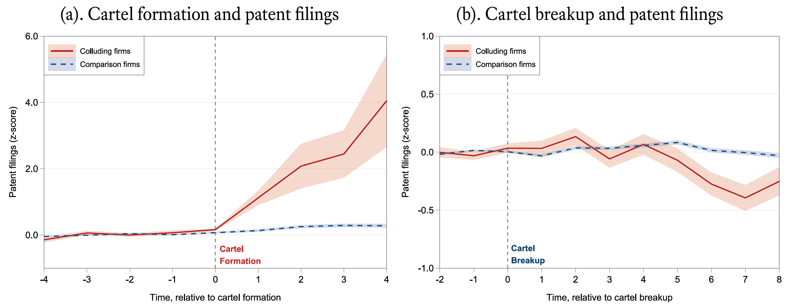
Intensity of Innovation: Patents
Model-free evidence
Presents raw data with minimal transformation (Z-score)
Overview
Setting
Design
Results
Mechanisms
Discussion

Slide 21
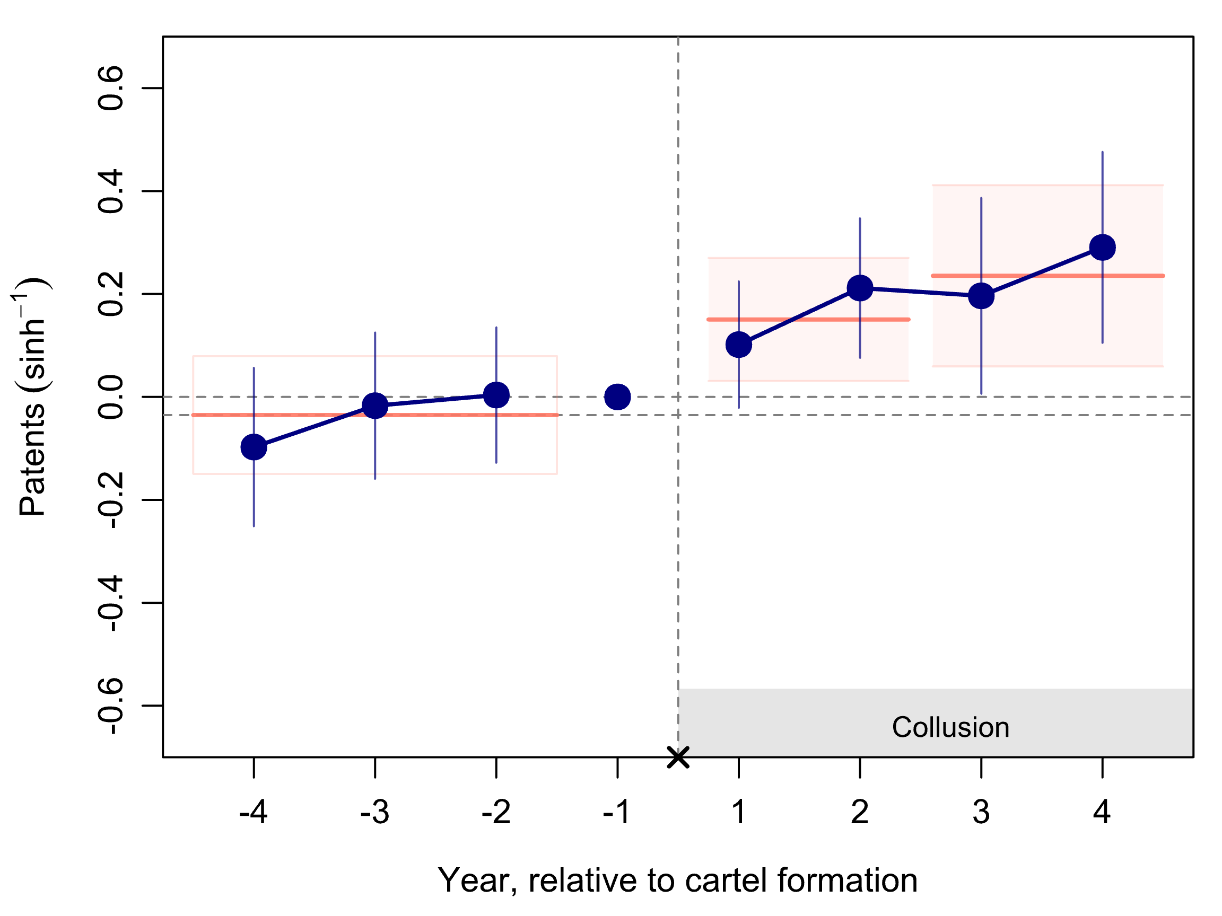
Intensity of Innovation: Patents
During collusion, patent applications increased by 28.3% (≈13.1)
Cartel Formation: Patents
Overview
Setting
Design
Results
Mechanisms
Discussion

Slide 22
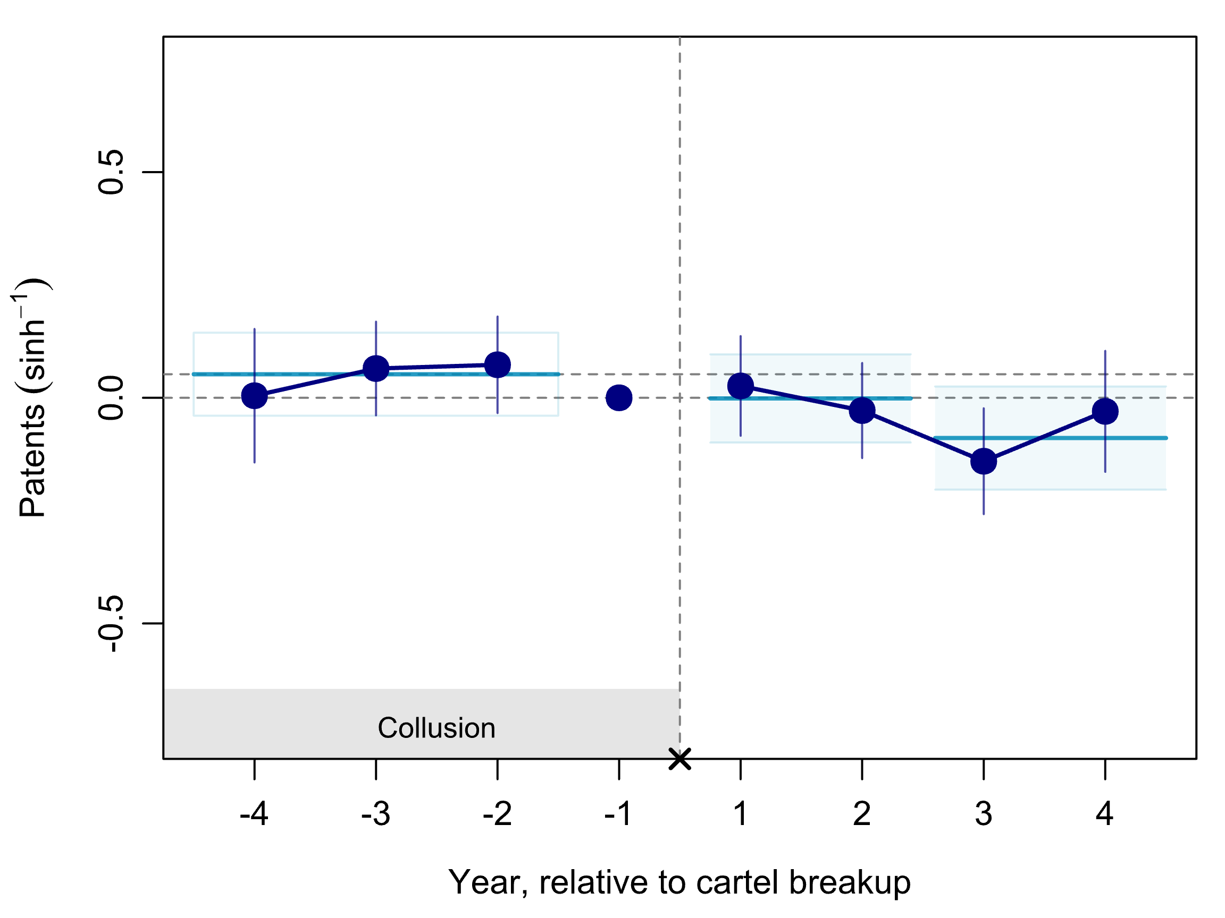
Intensity of Innovation: Patents
After collusion breakup, patent applications decreased
Firms would not instantaneously cease all ongoing R&D projects and patent filings after cartel breakup
Cartel Breakup: Patents
Overview
Setting
Design
Results
Mechanisms
Discussion

Slide 23
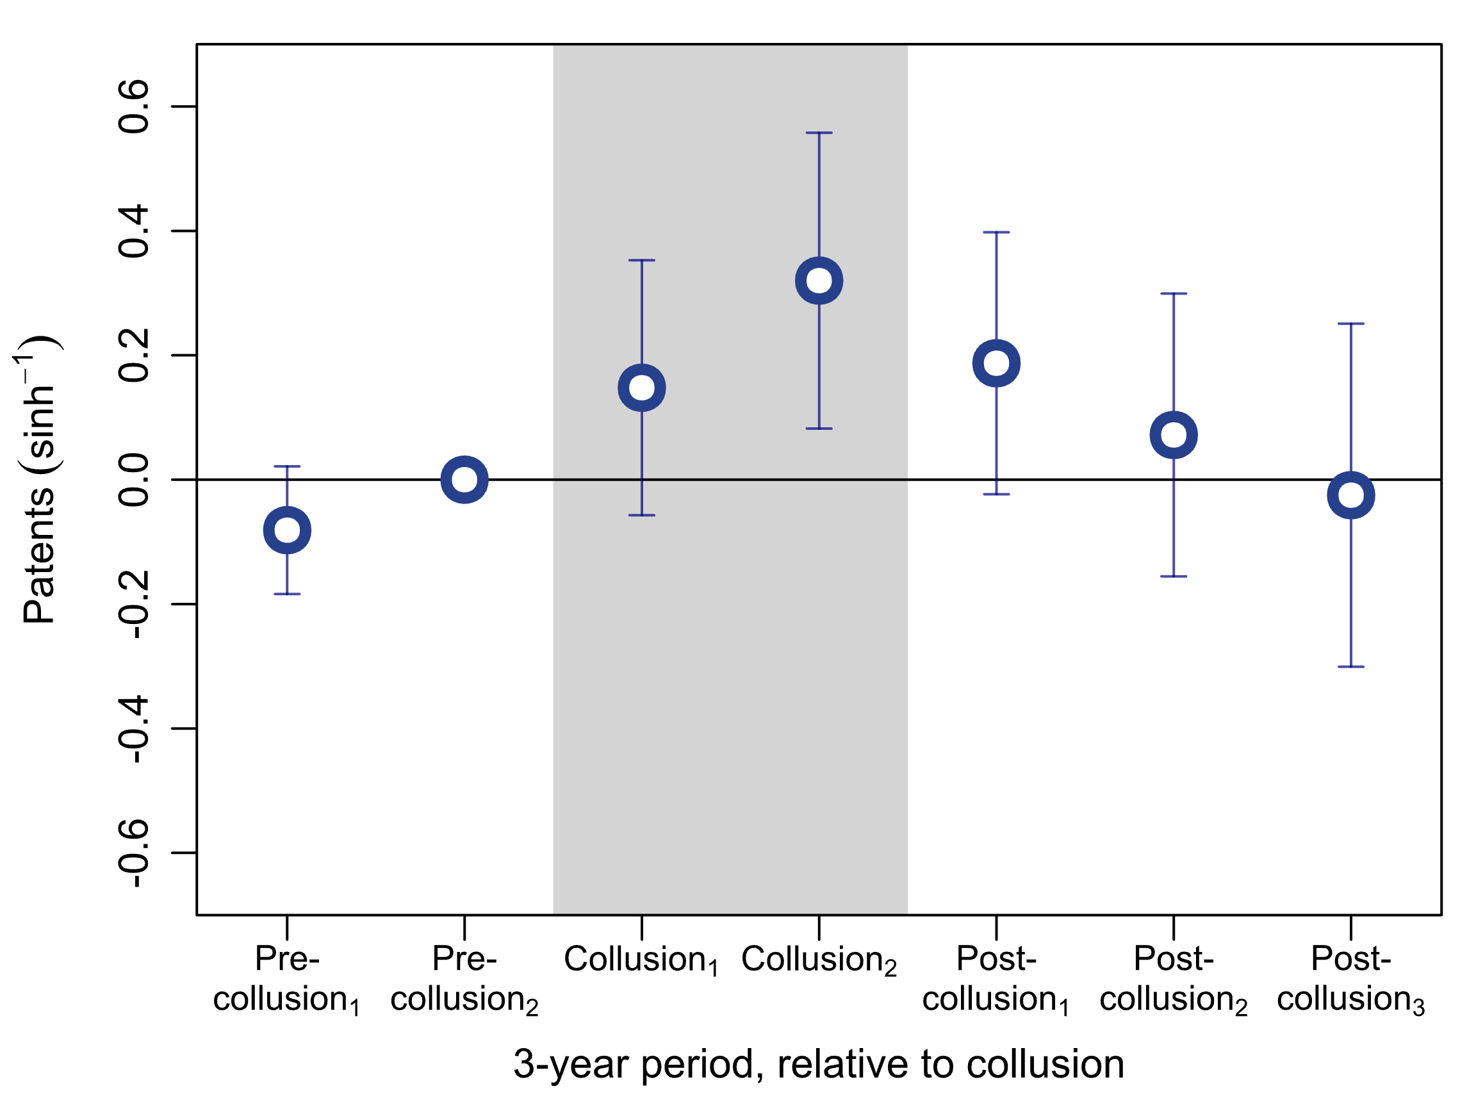
Intensity of Innovation: Patents
Single analysis that covers both formation and breakup
Each point represents the 3-year periods
Collusion duration differs: captures all later periods of collusion
Overview
Life Cycle of Collusion: Patents
Setting
Design
Results
Mechanisms
Discussion

Slide 24
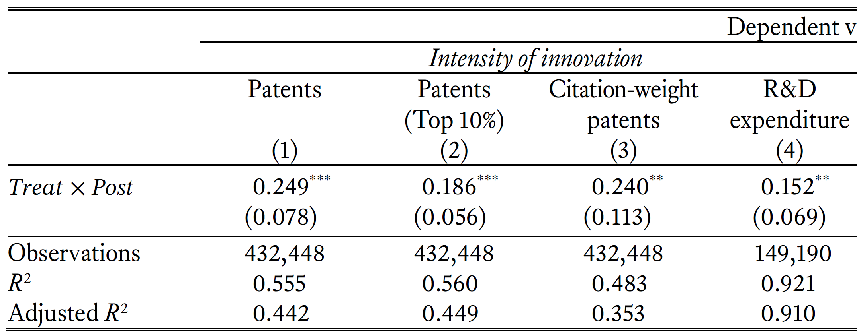
Intensity of Innovation: Alternative Measures
Quality-adjusted patents
High-quality patents (top 10% forward citations): 20.4%
Citation-weighted patents: 27.1%
Input for innovation
R&D expenditure (of public firms): 16.4%
Overview
Setting
Design
Results
Mechanisms
Dependent variables:
Discussion

Slide 25
Outline
Research Design and Data
Main Results
Intensity of innovation
Breadth of innovation
Mechanisms
Discussion
Overview
Setting
Design
Results
Mechanisms
Discussion

Slide 26
Breadth of Innovation
Innovation is a recombination of existing technologies in a novel fashion (Grant 1996; Henderson & Clark 1990; Kogut & Zander 1992)
Breadth of innovation provides diverse input for further innovation (unprecedented recombination)
Builds an absorptive capacity (Cohen & Levinthal 1990)
More difficult to broaden the scope of innovation
Firms that engage in non-core technology fields are substantially more likely to fail (Lampe and Moser 2013)
Overview
Setting
Design
Results
Mechanisms
Discussion
Notes:
Firms that engage in non-core technology fields are substantially more likely to fail (Lampe and Moser 2013)

Slide 27
Breadth of Innovation
Measurement: unique number of technology classes patented
4-digit Cooperative Patent Classification (CPC )
C04: Cements; concrete; artificial stone; ceramics; refractories
C05: Fertilizers; manufacture thereof
C05B: Phosphatic Fertilizers
C05C: Nitrogenous Fertilizers
C05D: Inorganic Fertilizers
C05F: Organic Fertilizers
C05G: Mixtures of fertilizers
C06: Explosives; matches
C07: Organic chemistry
Overview
Setting
Design
Results
Mechanisms
Discussion

Slide 28
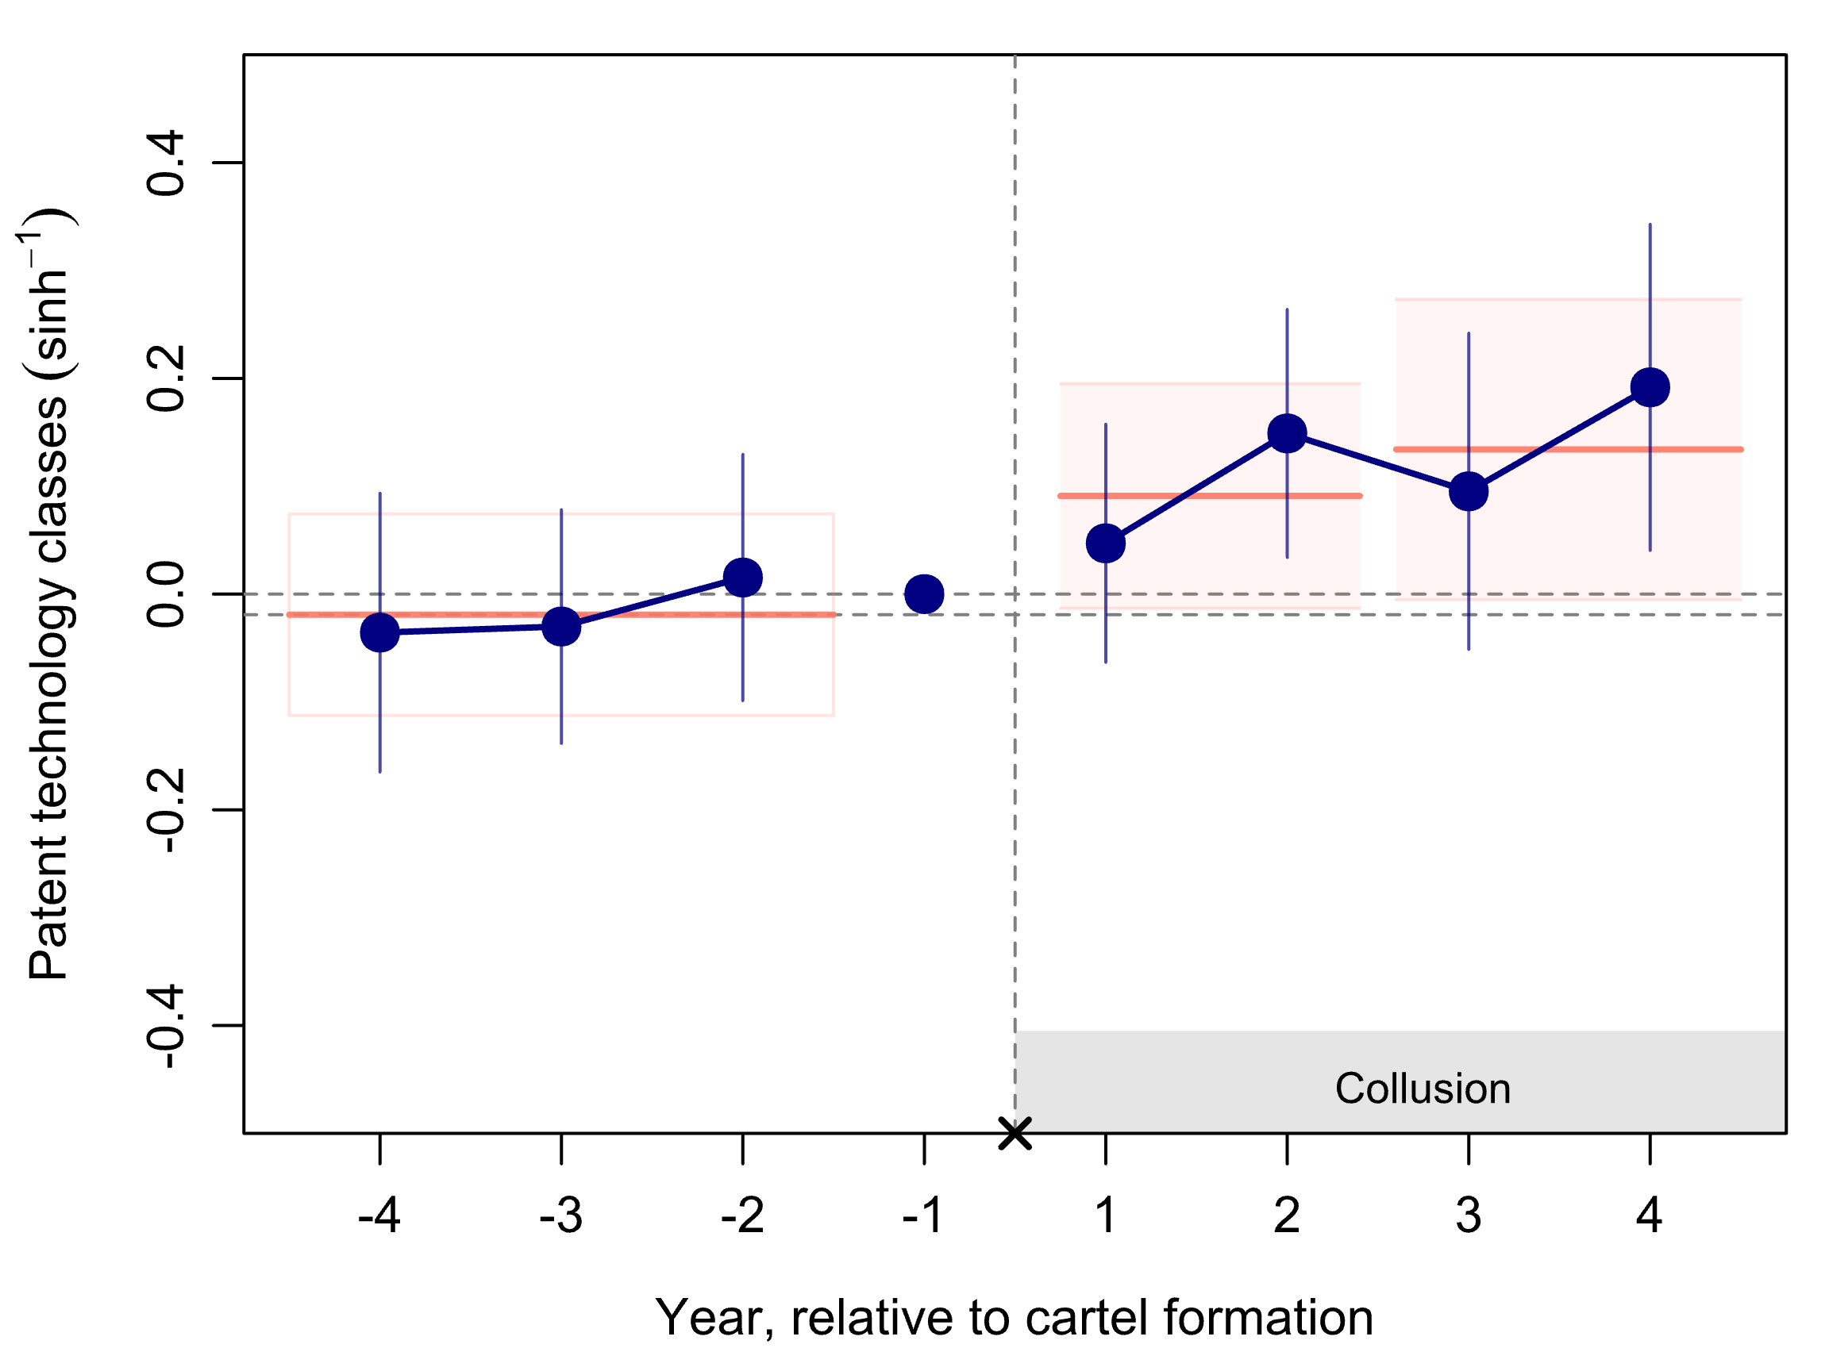
Breadth of Innovation: Unique Tech Classes
During collusion, firms broadened their technological search (16%)
Explored one (1) extra technology classes
Cartel Formation: Technology classes
Overview
Setting
Design
Results
Mechanisms
Discussion

Slide 29
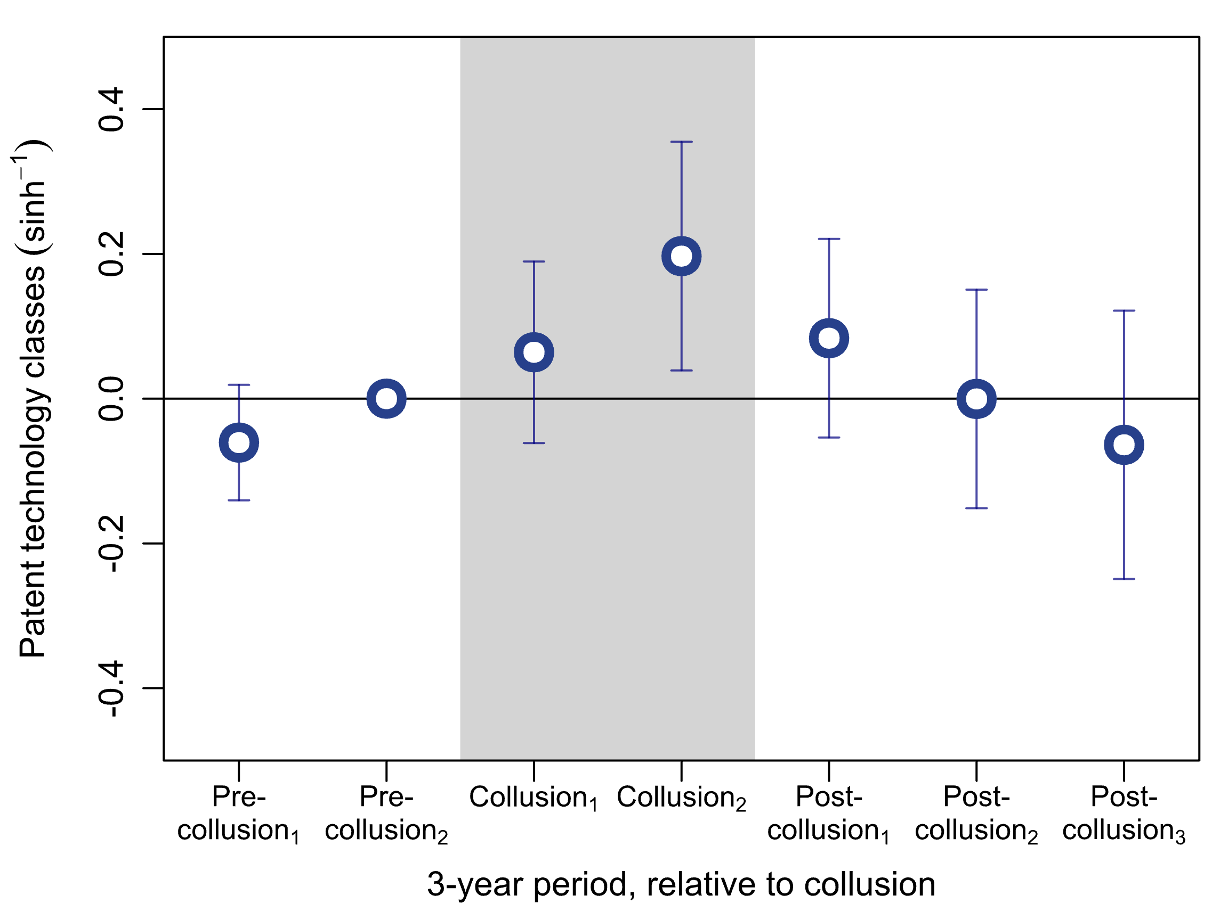
Breadth of Innovation: Unique Tech Classes
Single analysis that covers both formation and breakup
Life Cycle of Collusion: Technology classes
Overview
Setting
Design
Results
Mechanisms
Discussion

Slide 30
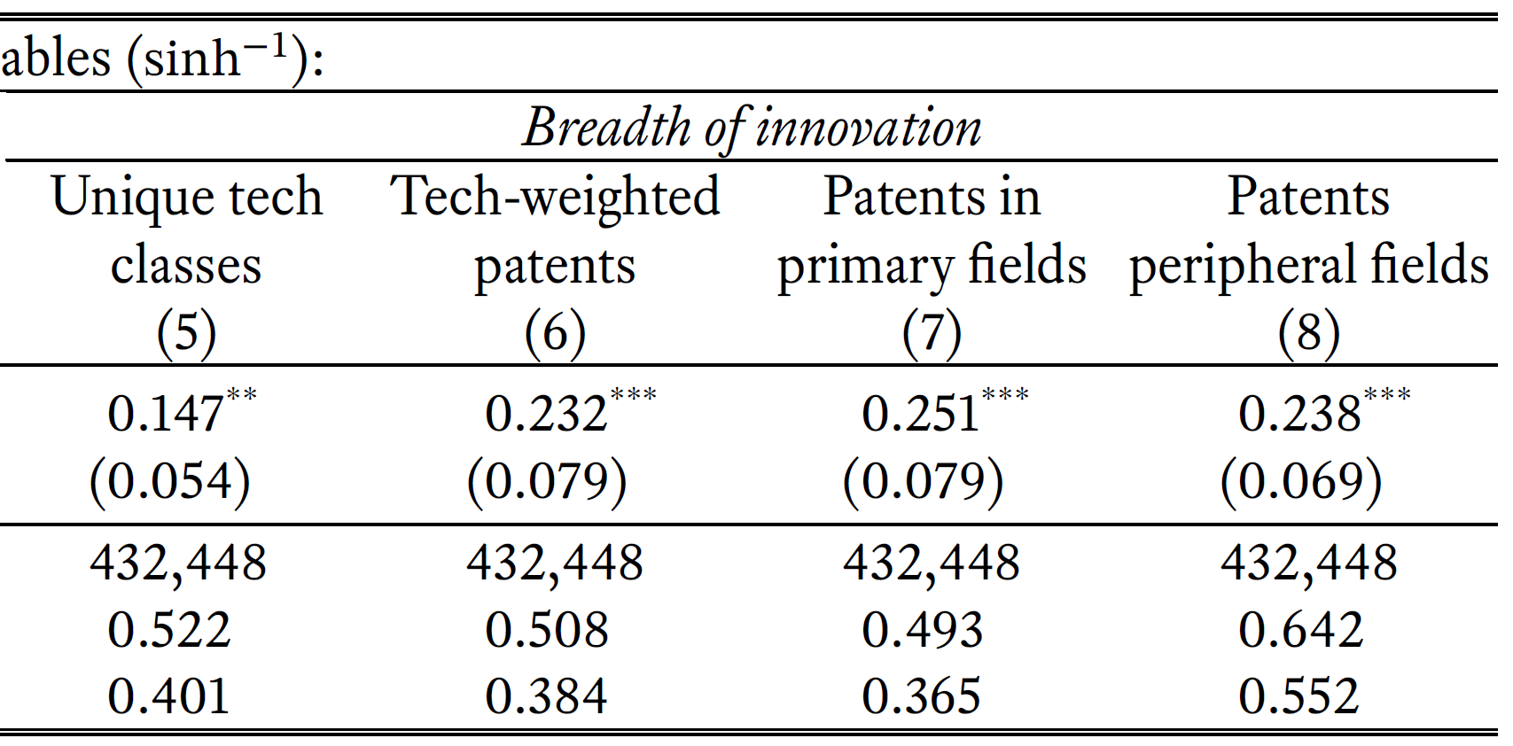
Breadth of Innovation: Alternative Measures
Technology class-weighted patents
Patents in peripheral fields
Excluding three frequently patented technology classes
Overview
Setting
Design
Dependent variables:
Results
Mechanisms
Discussion

Slide 31
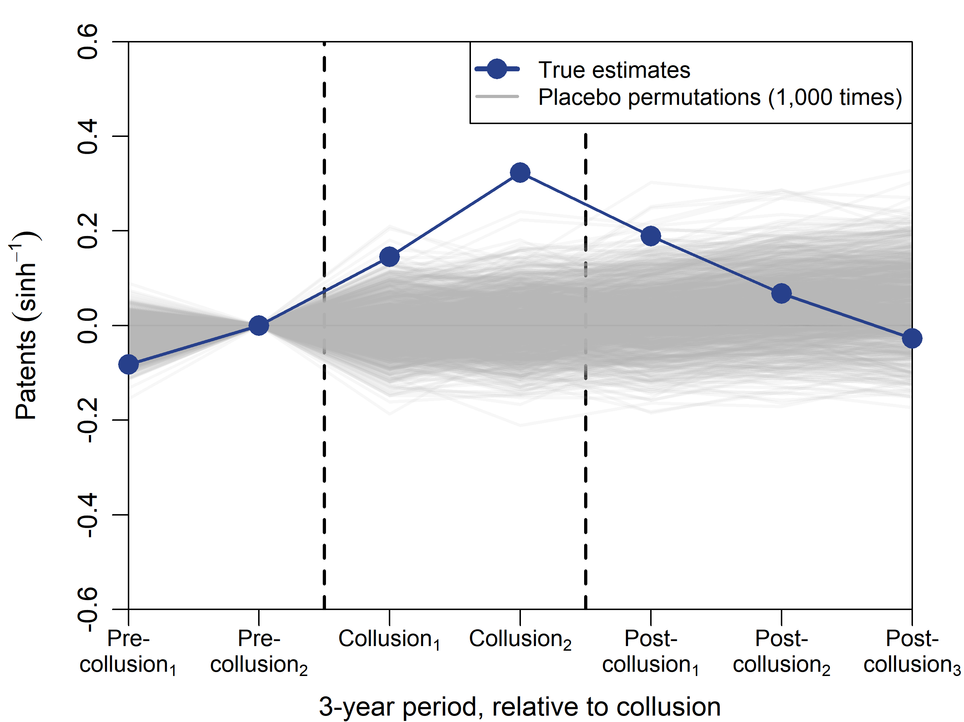
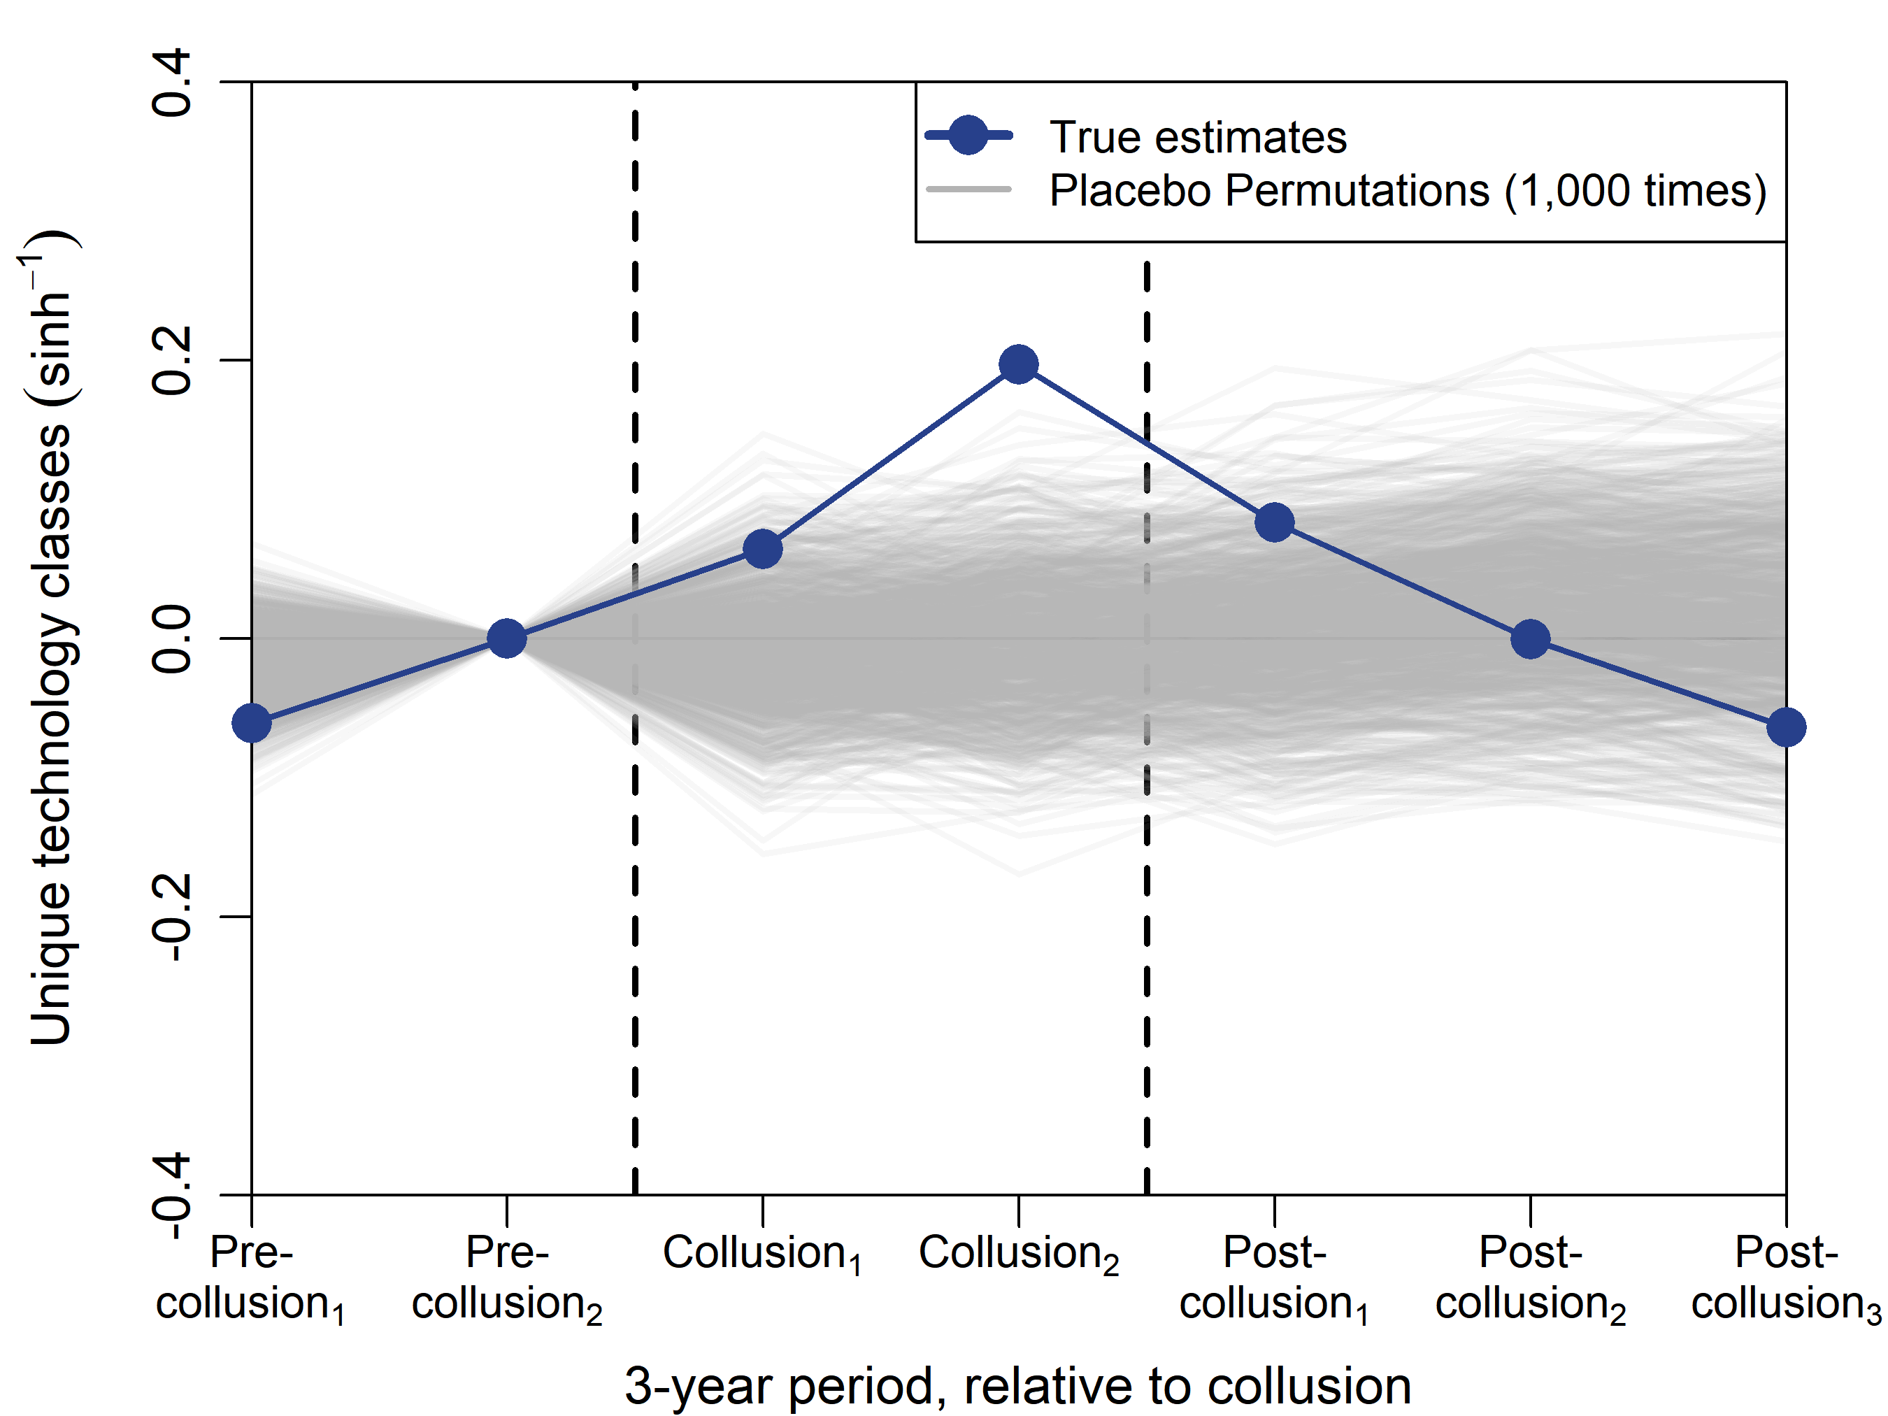
Placebo permutation tests
Randomly reassigned treatment status within 4-digit NAICS
Treated non-colluded firms as if they colluded
Simulated 1,000 times (gray lines)
Overview
Setting
Innovation intensity
Innovation breadth
Design
Results
Mechanisms
Discussion

Slide 32
Outline
Research Design and Data
Main Results
Mechanisms
Discussion
Overview
Setting
Design
Results
Mechanisms
Discussion

Slide 33
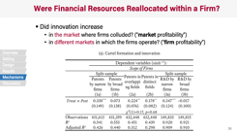
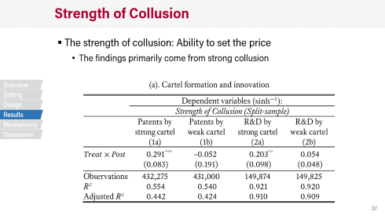
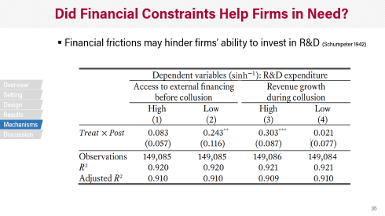
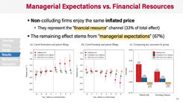
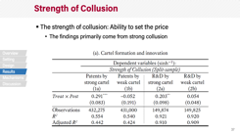
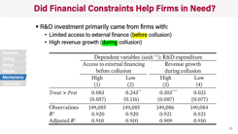
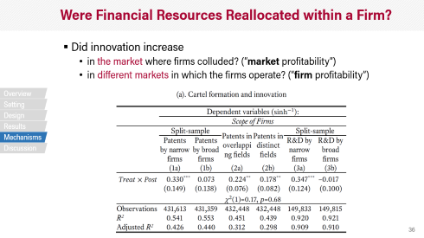
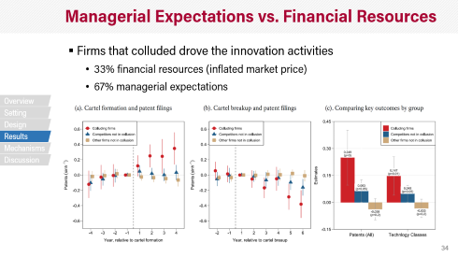
Further Analyses of the Mechanisms
Managerial Expectations vs. Financial Resources
Did Financial Constraints
Help Firms in Need?
Overview
Setting
Design
Results
Mechanisms
Discussion
Were Financial Resources Reallocated within a Firm?
Strength of Cartel

Slide 34
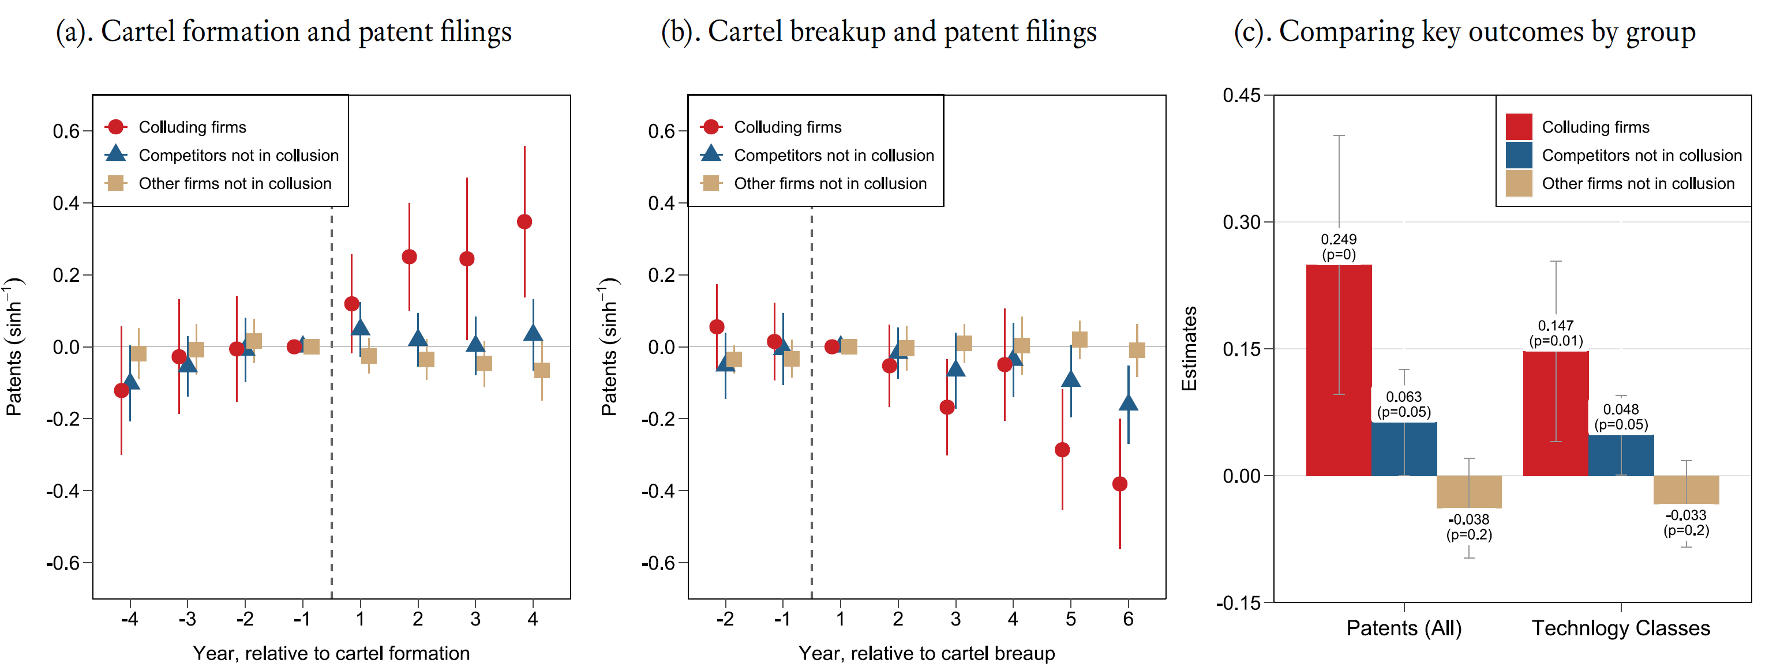
Managerial Expectations vs. Financial Resources
Non-colluding firms enjoy the same inflated price
They represent the “financial resource” channel (33% of total effect)
The remaining effect stems from “managerial expectations” (67%)
Overview
Setting
Design
Results
Mechanisms
Discussion

Slide 35
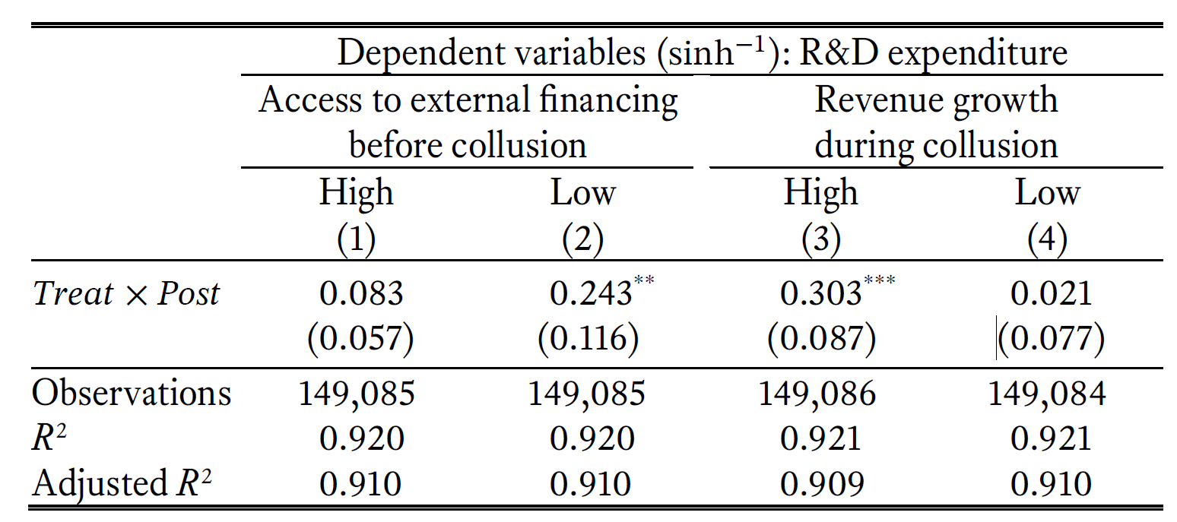
Did Financial Constraints Help Firms in Need?
R&D investment primarily came from firms with:
Limited access to external finance (before collusion)
High revenue growth (during collusion)
Overview
Setting
Design
Results
Mechanisms
Discussion
Notes:
Measured revenue growth rate during collusion

Slide 36
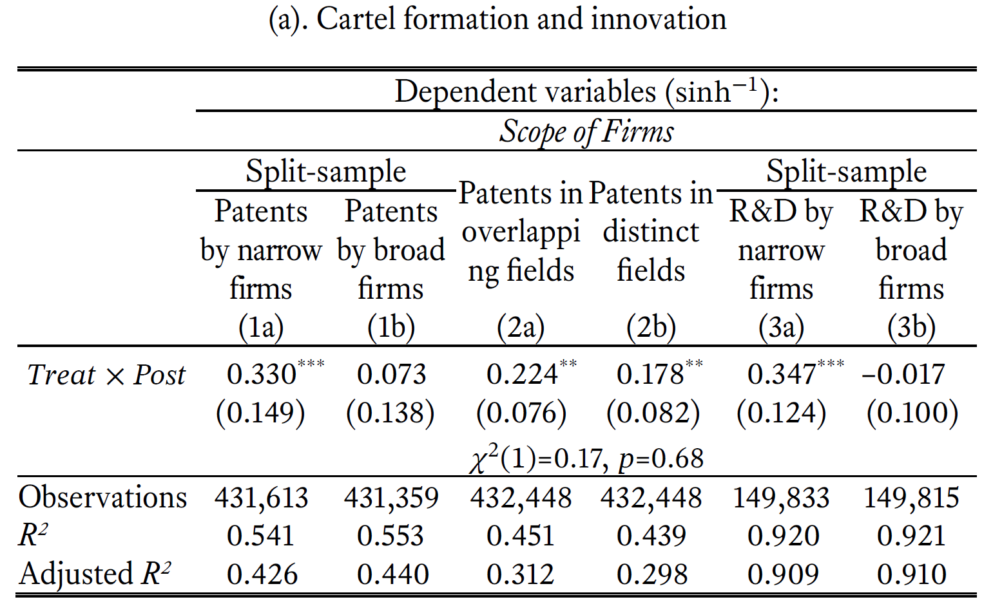
Were Financial Resources Reallocated within a Firm?
Did innovation increase
in the market where firms colluded? (“market profitability”)
in different markets in which the firms operate? (“firm profitability”)
Overview
Setting
Design
Results
Mechanisms
Discussion
Notes:
Narrow firms: technology class HHI (above median)
Overlapping fields: five most frequent intersection of patented technology classes across all colluded firms
R&D by narrow: 1-2 business segments

Slide 37
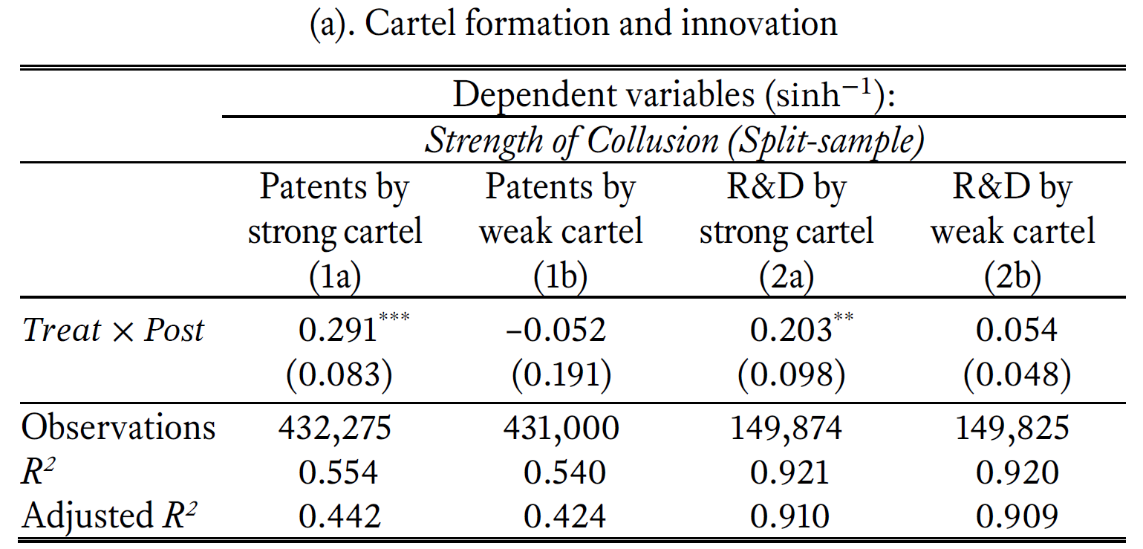
Strength of Collusion
The strength of collusion: Ability to set the price
The findings primarily come from strong collusion
Overview
Setting
Design
Results
Mechanisms
Discussion

Slide 38
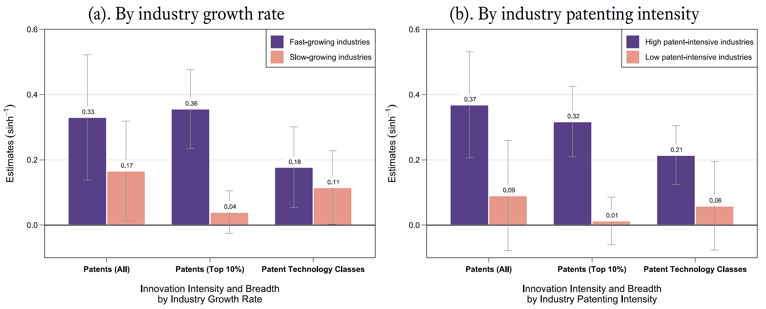
Variation by Industry
Industries experiencing rapid growth and high patent activity are most likely to see the pro-innovation effects
Overview
Setting
Design
Results
Mechanisms
Discussion

Slide 39
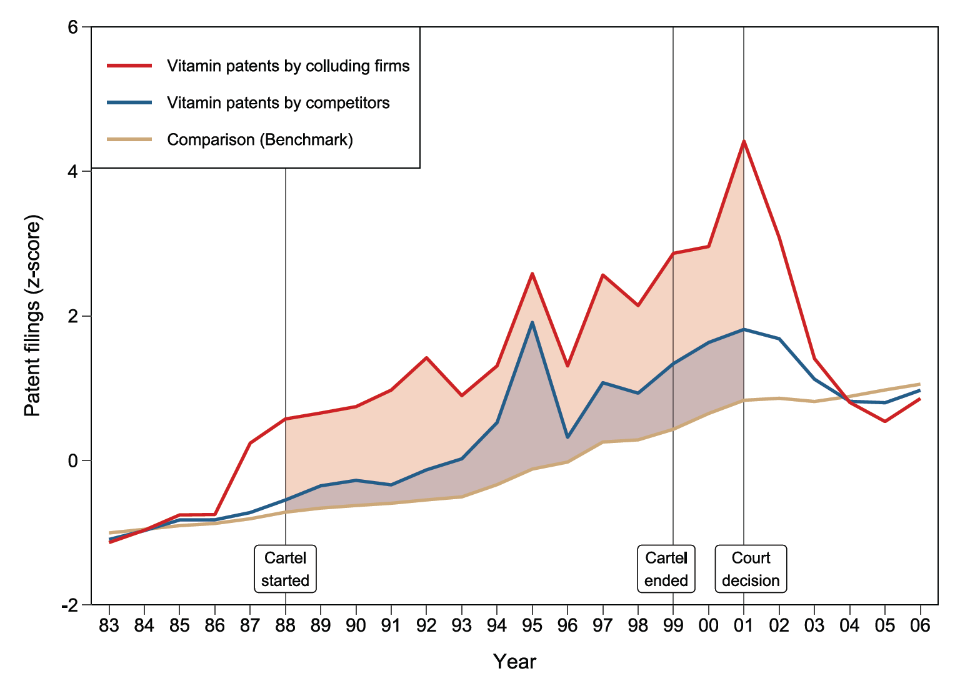
Case Study: Vitamin Cartel
Overview
Setting
Design
Results
Mechanisms
Discussion
Notes:
Measured revenue growth rate during collusion

Slide 40
Outline
Research Design and Data
Main Results
Mechanisms
Discussion
Overview
Setting
Design
Results
Mechanisms
Discussion

Slide 41
Implications
Innovation is likely underprovided (Arrow 1962; Griliches 1992; Bloom et al. 2013)
“the gross social returns to R&D are at least twice as high as the private returns” (Bloom et al. 2013)
When price competition weakens, firms shift toward innovation competition
An important change in the rules of the game
Trade-off between price competition and innovation growth
What should be the policy goal? (Cheaper product vs. better product)
Should also consider the breadth (and types) of innovation
Feature phone vs. Smartphone; Me-too drugs vs. novel drugs
Overview
Setting
Design
Results
Mechanisms
Discussion
Notes:
Innovation is an important strategic decision
Determines long-term competitive advantage and performance
In this setting in which firms operate in technology-intensive industries and collude to fix prices, firms shift toward innovation competition and broaden their search for new technological opportunities when price competition weakens
Sheds light on the important trade-off between price competition and innovation growth
Broadens our understanding of the effects of competition beyond the price level
Firms not only change the intensity of innovation but also alter the breadth of their technological search and innovation,
both of which consequently affect the novelty of future innovations

Slide 42
Concluding Remarks
New evidence on how price competition changes firm innovation activities
Context: cartels in the knowledge-intensive industries
Caution: generalizability
The whole competition space?
Other types of competition? (e.g., Chinese import penetration)
Large firms with market power versus small price-taking firms
Industry characteristics (high growth & patent-intensive)
Overview
Setting
Design
Results
Mechanisms
Discussion
Notes:
Cf. Other types of competition (import penetration, etc.)

Slide 43

Thank You!

Slide 44
APPENDIX
Additional Slides
Patent Data Construction & Analysis
Timeline of Antitrust Enforcement
Aghion et al. (2005): an inverted-U relationship
Plea Agreement
Regression Tables
Temporal Heterogeneity
International Companies
Criminal Fines
Overview
Setting
Design
Results
Mechanisms
Discussion

Slide 45
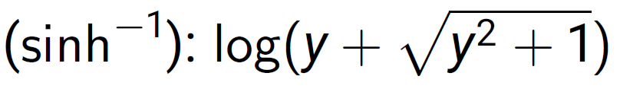
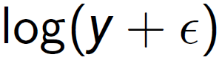
Patent Data Construction & Analysis
Patent data: identified the first/last year of patenting for each firm and transformed the data into firm-year level panel
Count variable analysis
Inverse hyperbolic sine transformation:
Defined at 0
Has the same interpretation as a standard log dependent variable (Burbidge, Magee, and Robb, 1988; MacKinnon and Magee, 1990; Pence, 2006; Kline, Petkova, Williams, and Zidar, 2017)
Log transformation:
Poisson Quasi Maximum Likelihood Estimation

Slide 46
Timeline of Antitrust Enforcement
Example: Maxzone Vehicle Lighting Corp (Taiwan)
Collusion (estimated)
Indictment
Plea Hearing
Trial
Sentence
Appeal
2000/04/01
2008/09/08
2011/09/12
2011/11/15
True begin date
may be earlier
than estimation
Approved
($43 million
Criminal fine)

Slide 47
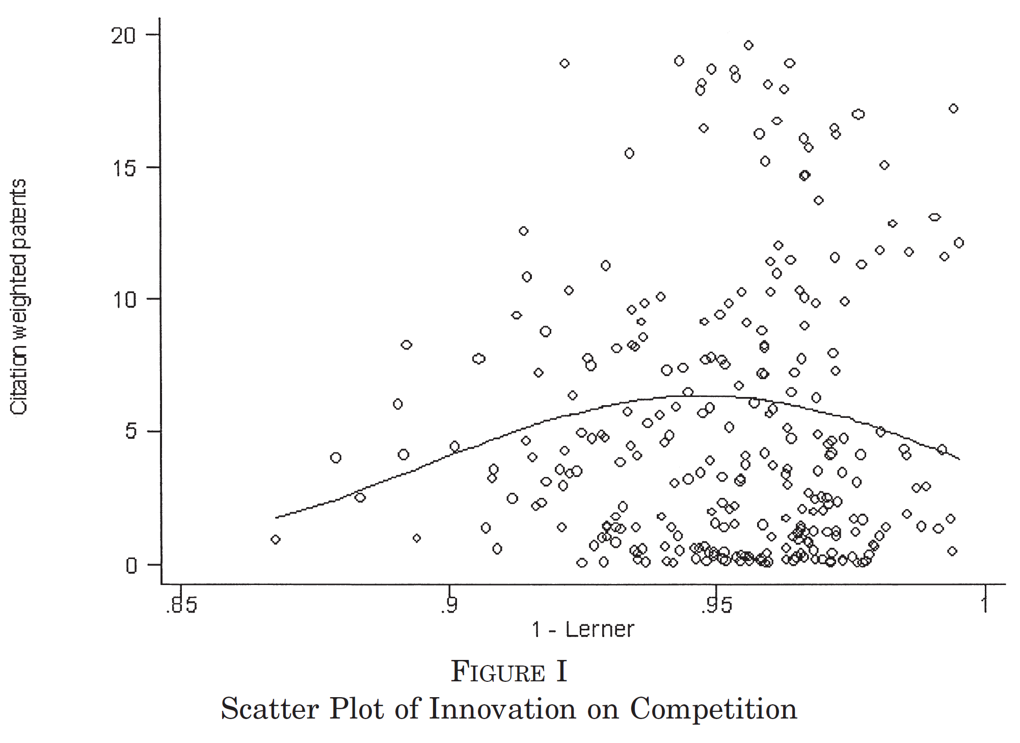
An Inverted-U Relationship
Aghion, Bloom, Blundell, Griffith, and Howitt (2005; QJE)
Industry-level analysis (two-digit SIC)
Average Lerner Index
Average patenting of U.K. firms in the U.S.
Perfect
Competition
0
Monopoly

Slide 48
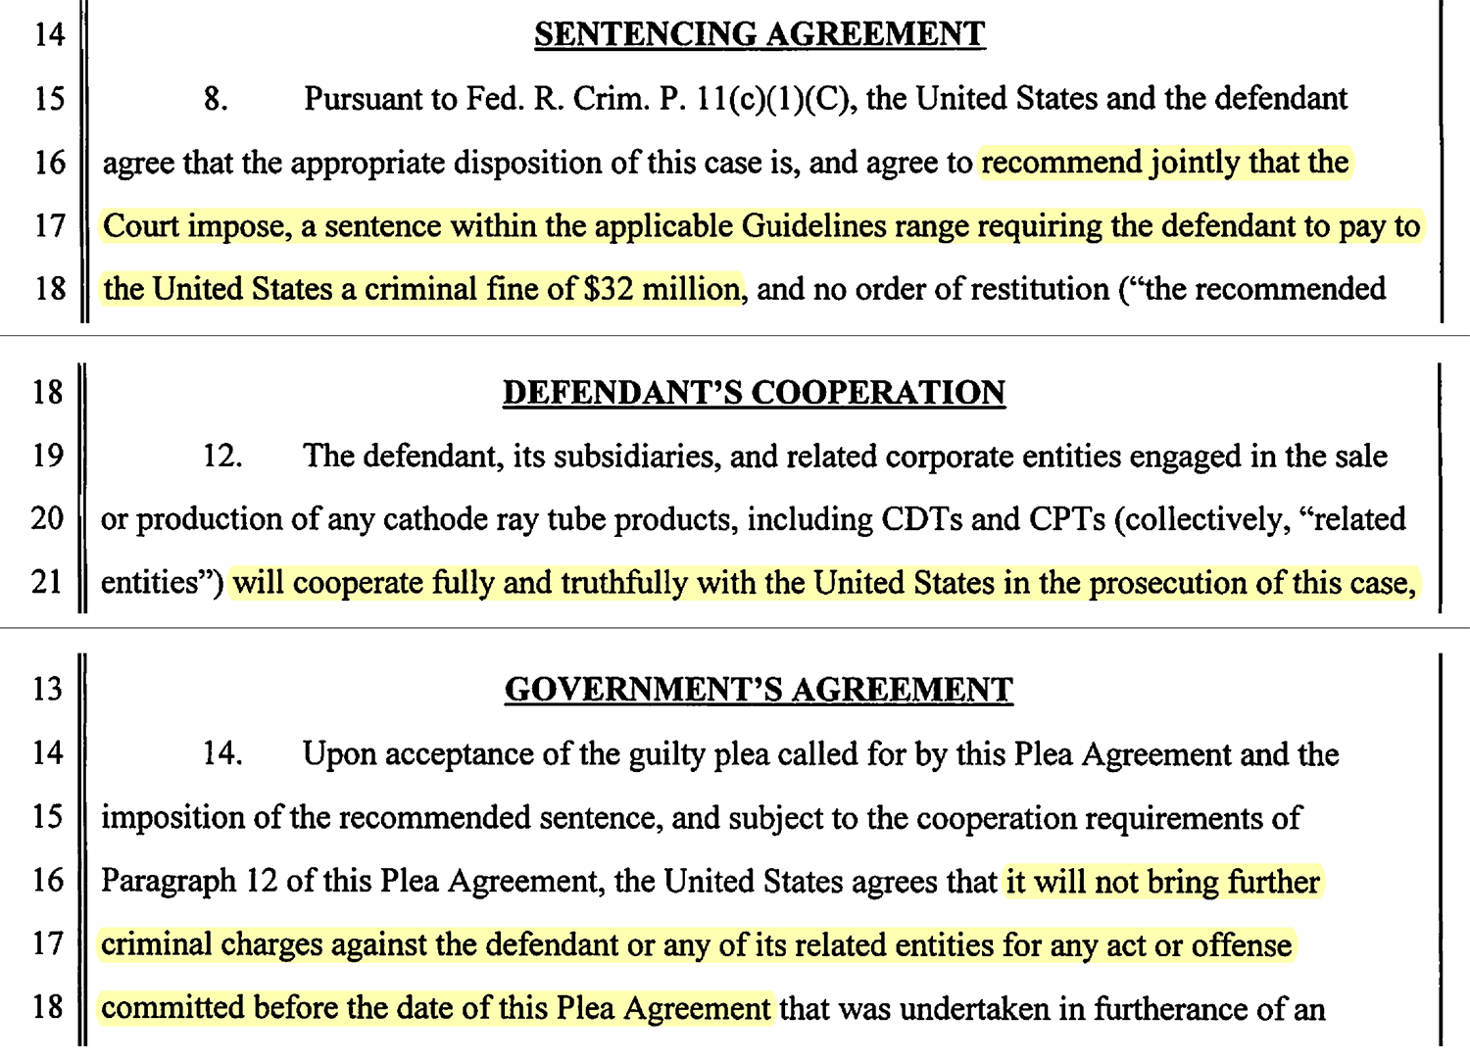
Plea Agreement – 16 pages

Slide 49
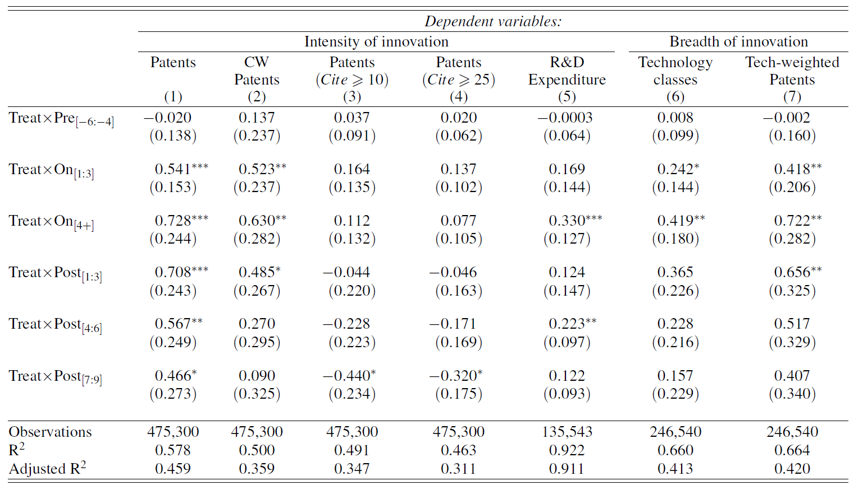
Regression Tables
Life Cycle of Cartels and Innovation

Slide 50
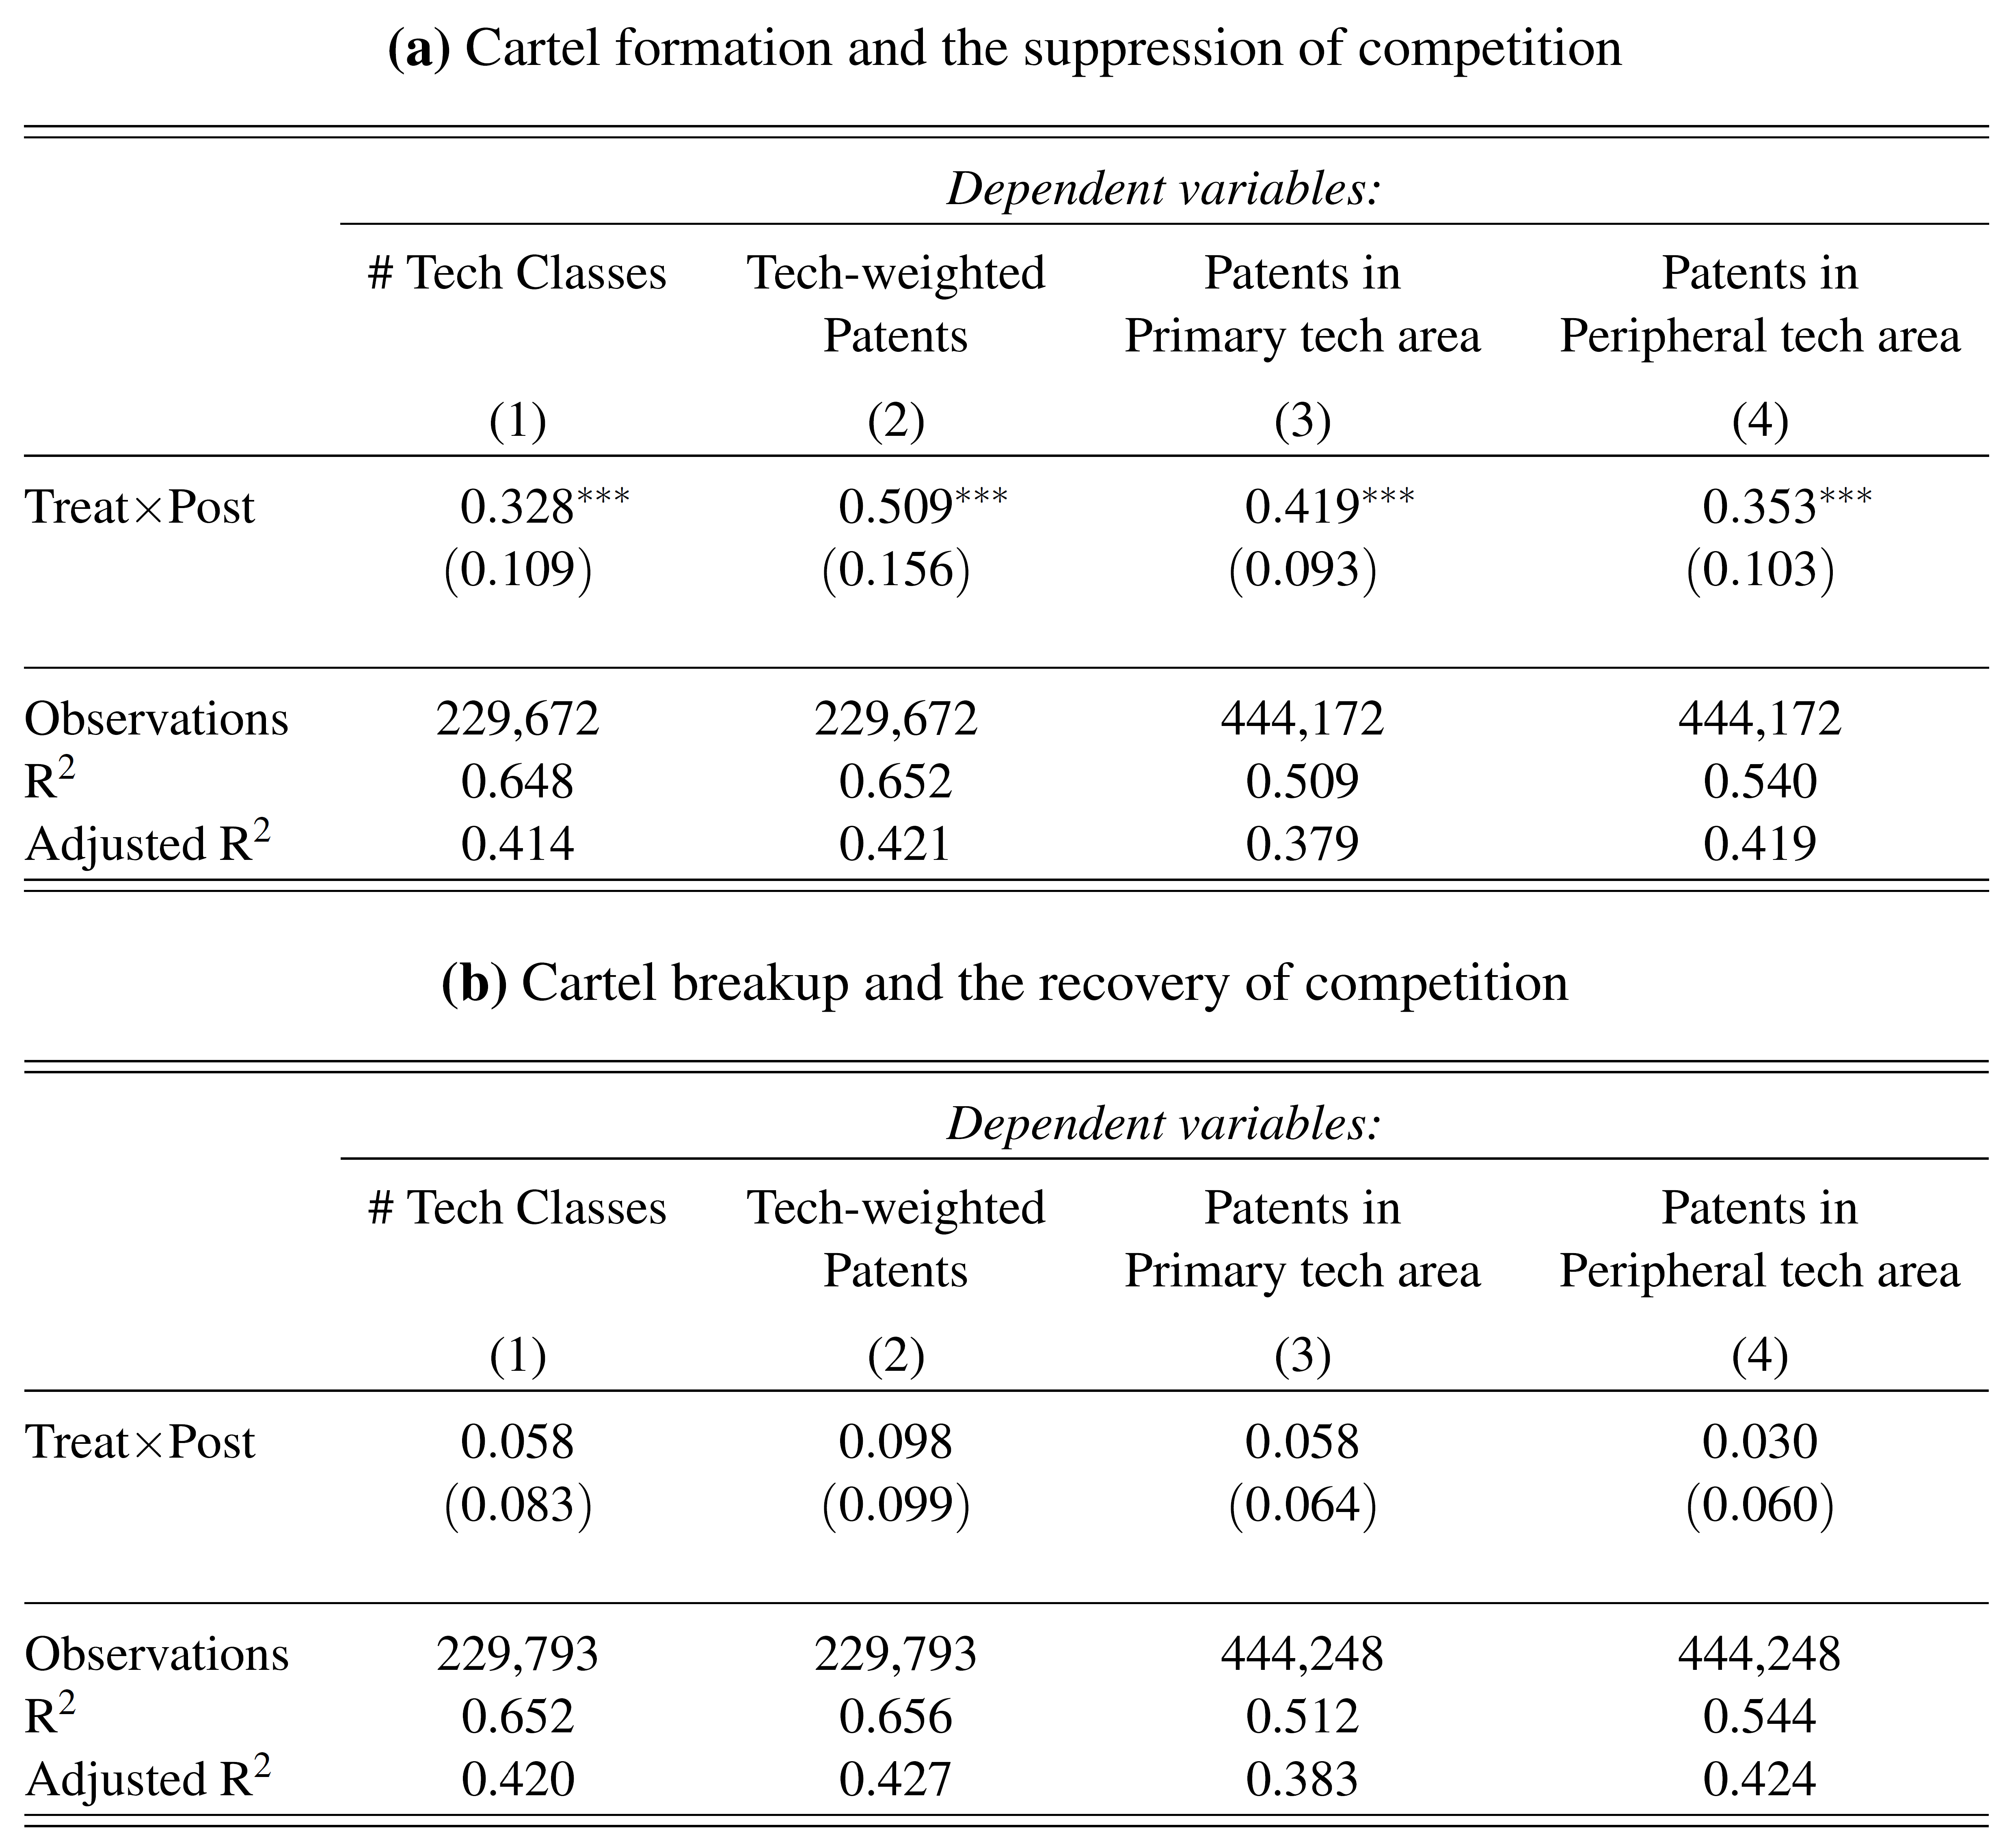
Regression Tables
DID Results: Main vs. Peripheral Area

Slide 51
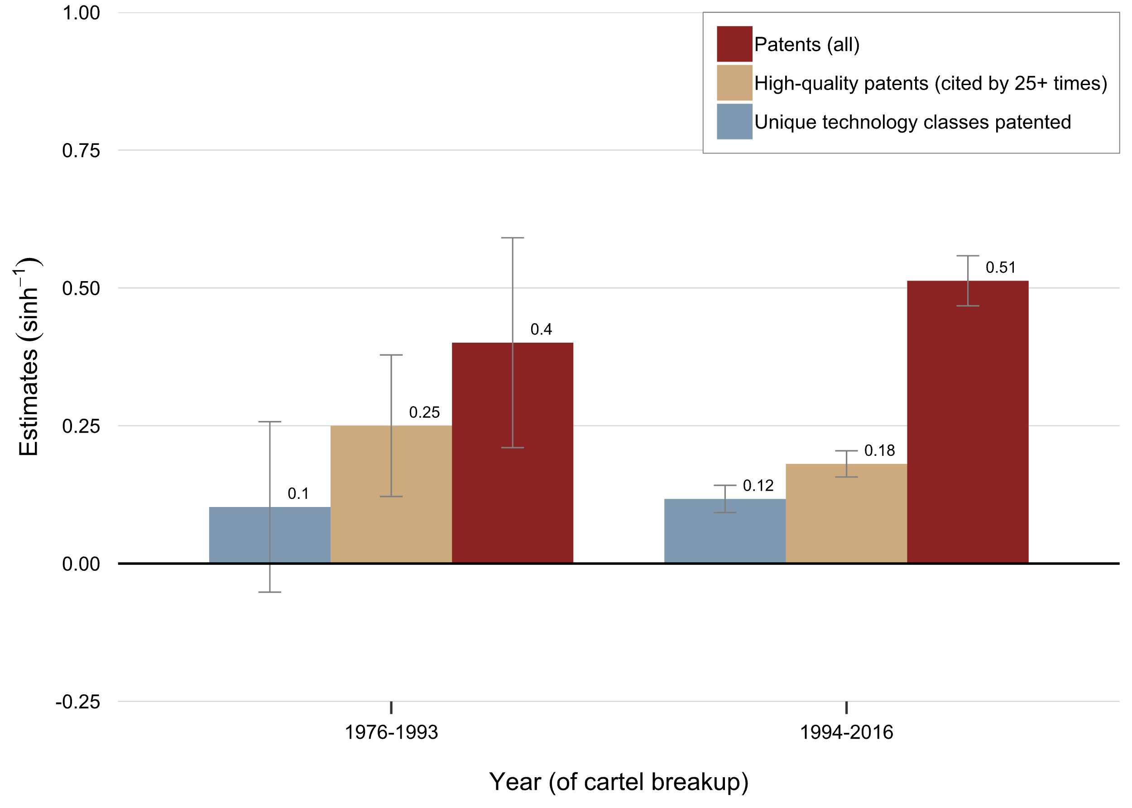
Temporal Heterogeneity: Leniency Program (1993)
Revision in the Leniency Program (Corporate ’93; Individual ’94)

Slide 52
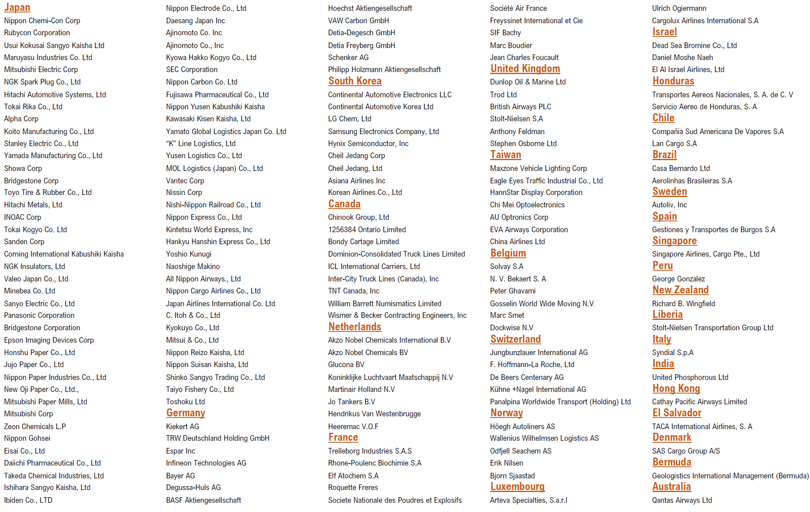
International Companies

Slide 53
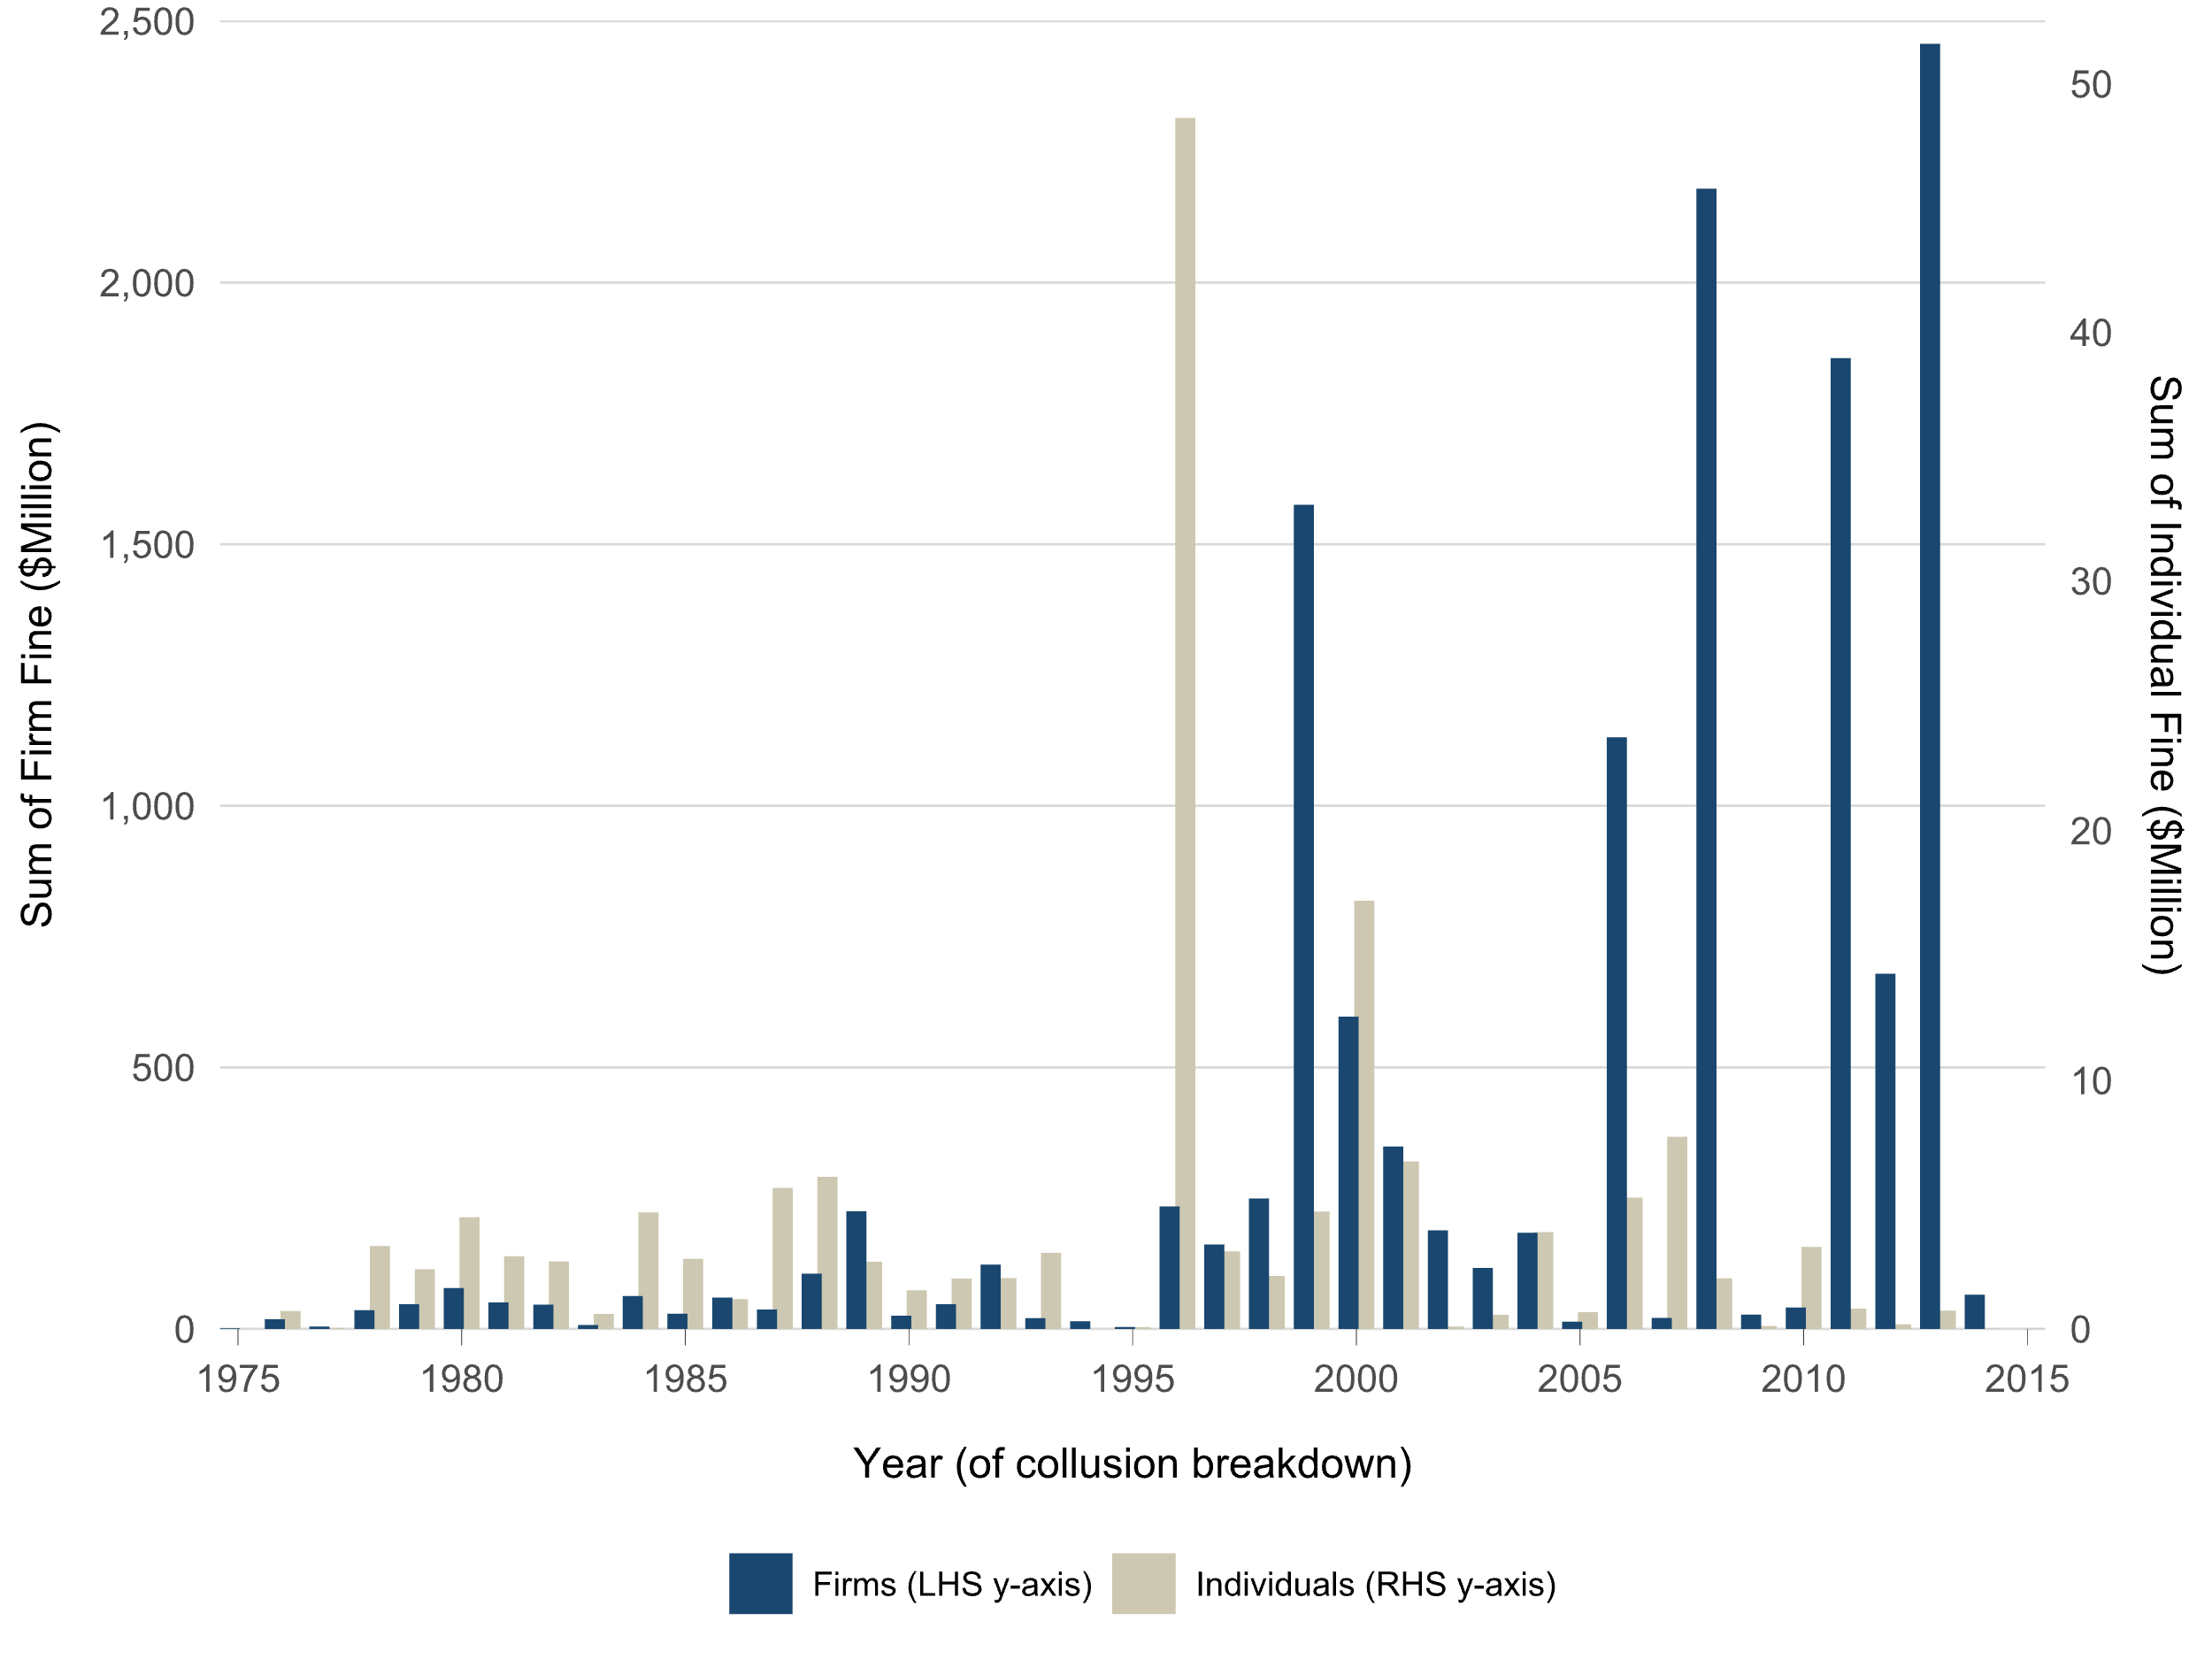
Criminal Fines

Slide 54
An Experiment: Bracha & Fershtman (2013; MS)
Harvard students choose and solve questions (10 minutes)
Randomly assigned to two treatments:
Competition (head-to-head tournament)
No competition (pay-per-performance)
Under competitive incentives,
Less time devoted to Question B
Lower success rate for Question B
Question A (“Labor Effort”): $1
Question B (“Cognitive Effort”): $5
73
9 30 51
□ Even □ Odd
What is the missing number?

Slide 55
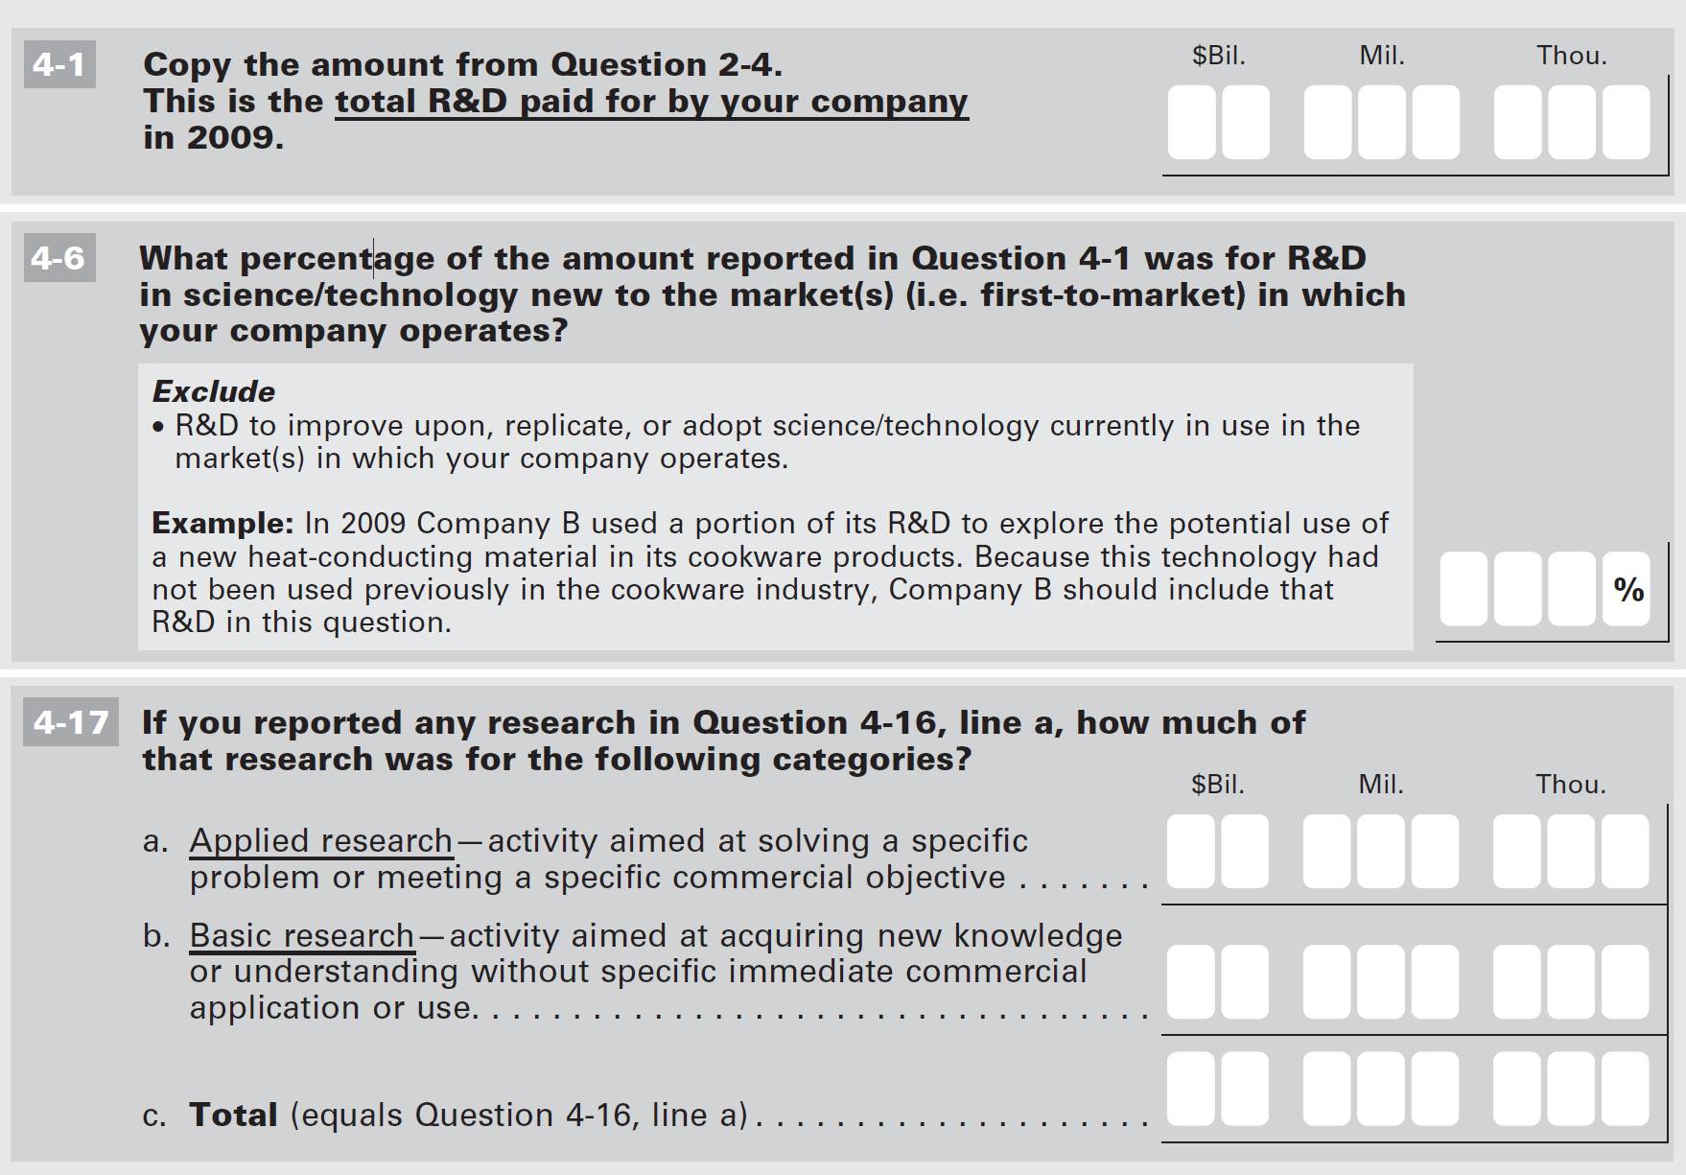
Census Microdata: SIRD (’72-07) & BRDIS (’08-16)

